Slide 1
Cluster Analysis for Data Science with Python
Dave Langer
TDWI San Diego, August 2023

Slide 2
Want to have more impact at work using data
Have basic Python skills (e.g., completed the Quick Start)
Willingness to learn Python code and some math
Download course materials from:
https://github.com/DaveOnData/TDWIClusterAnalysisWithPython
Laptop prep
Have fun!
Expectations of You
Cluster analysis is a vast topic. We can’t cover it all
We’ll follow the 80/20 Rule
focus on the 20% that is useful 80% of the time
A practical use of Python to perform cluster analysis
Advanced topics (e.g., dimension reduction) are out of scope
Expectations of the Course

Slide 3
Introduction
Section 1

Slide 4
What is Cluster Analysis?
“Cluster analysis groups data objects based only on information found in the data that describes the objects and their relationships.”
“The goal is that the objects within a group be similar (or related) to one another and different from (or unrelated to) the object in other groups.”
“The greater the similarity (or homogeneity) within a group and the greater the difference between groups, the better or more distinct the clustering.” [Pan 2005]
Because cluster analysis has no external information about groups (i.e., labels), it belongs to a form of machine learning known as unsupervised learning.
Because so much data is unlabeled, cluster analysis is a widely used tool in analytics to discover structure in data and produce new insights.
BTW – The words groups and clusters are interchangeable in this course.
Notes:
[Pan 2005] - “Introduction to Data Mining” by Pang-Ning, Michael Steinbach, and Vipin Kumar, first edition May 2, 2005.
For more information, check out the following helpful Wikipedia articles:
https://en.wikipedia.org/wiki/Cluster_analysis
https://en.wikipedia.org/wiki/Unsupervised_learning

Slide 5
Why Cluster Analysis?
Much effort is put into examining objects in the world and assigning the objects to classes.
For example, biologists have created a taxonomy for classifying animals – kingdom, phylum, class, etc.
Cluster analysis automates the process of discovering classes directly from data.
Not surprisingly, this is extremely useful across many scenarios:
Marketing – Segmenting customers into classes to better understand similarities in backgrounds/behaviors
IT Operations – Anomaly detection in network operations and security
Text Analytics – Assigning documents to classes based on the similarity of content
Supply Chain – Grouping customer deliveries to optimize warehouse locations
And the list goes on!
BTW – You can think of group, cluster, and class as being interchangeable in this course.
Notes:
To see how much effort biologists have put into developing a classification taxonomy, check out the following Wikipedia article:
https://en.wikipedia.org/wiki/Taxonomy_(biology)

Slide 6
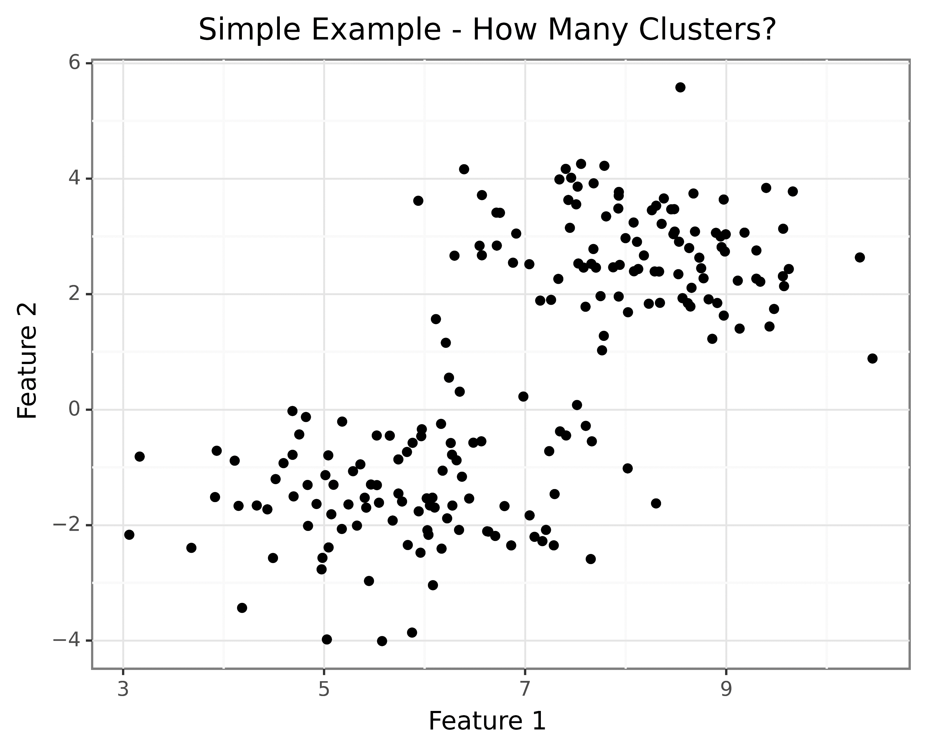
The Challenge – Simple Clusters

Slide 7
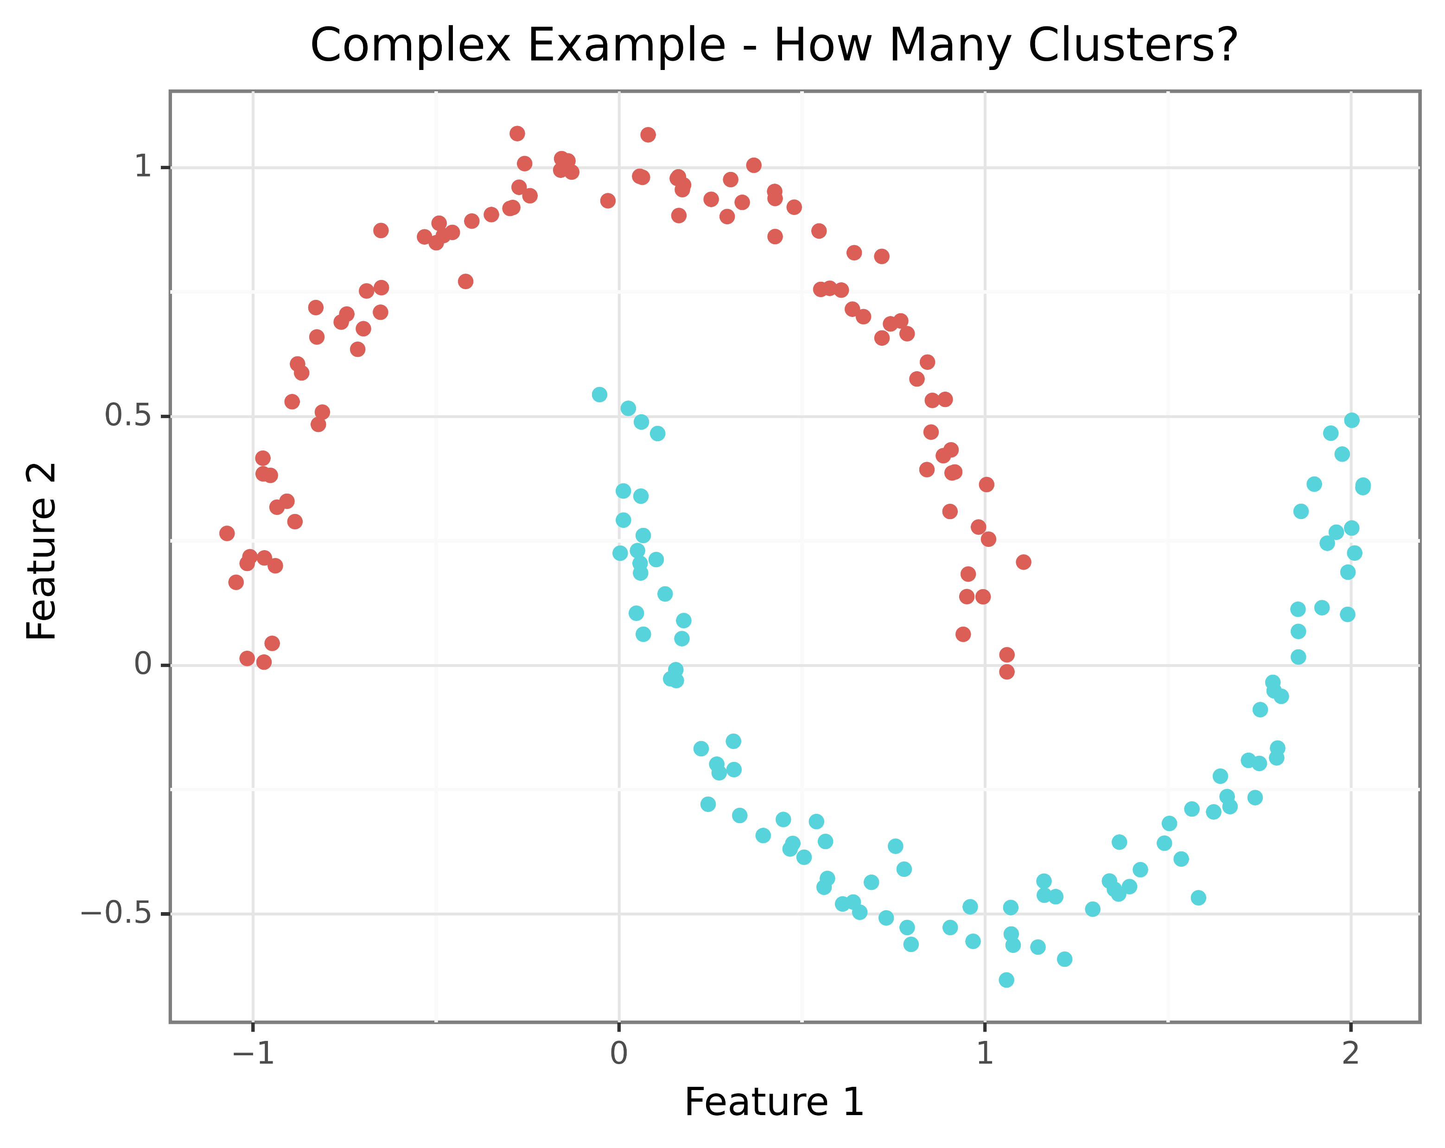
The Challenge – Complex Clusters

Slide 8
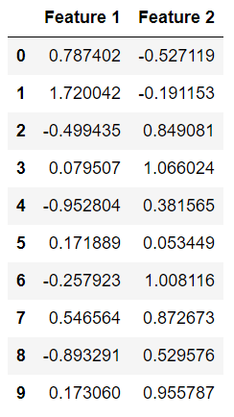
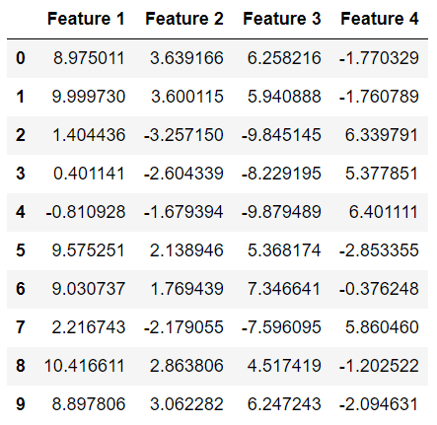
The Challenge – Lots of Data
The prior examples were built from simple datasets that look like this:
Clustering is typically done with datasets with many more features:
Cluster analyses are conducted using 100s, even 1000s of columns!

Slide 9
Datasets
Section 2

Slide 10
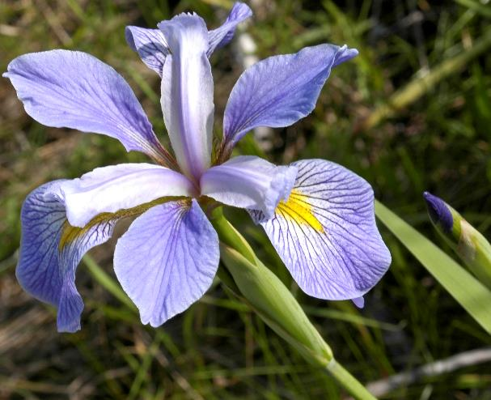
The Iris Dataset
The famous iris data set will be used in the course lecture slides.
The data set consists of 50 rows for each of three species of iris flower – setosa, versicolor, and virginica.
Each observation consists of the following data:
Petal
Variable | Data Type
Sepal Length | Numeric (cm)
Sepal Width | Numeric (cm)
Petal Length | Numeric (cm)
Petal Width | Numeric (cm)
Species | Categorical
Class Labels!!!
Sepal
Why use a dataset with class labels?
Isn’t the point of cluster analysis to find the classes?
Iris Virginica
Notes:
While clustering algorithms are specifically designed to find the classes (i.e., groups/clusters) from data without class labels, it is beneficial to learn clustering algorithms using labeled data. By having the class labels (i.e., the “ground truth”) present, it is easy to compare clustering results and understand the various tradeoffs present in cluster analysis (e.g., how different algorithms perform).

Slide 11
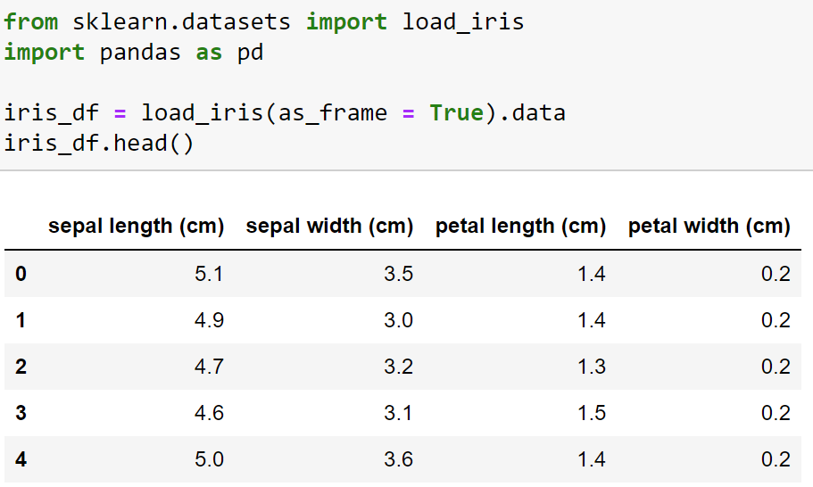
The Iris Dataset
The iris dataset is available via the scikit-learn library:
Dataset, table,
dataframe
Column, feature,
Variable,
dimension
Row, observation,
example,
sample
Notes:
More information about scikit-learn’s support for the iris dataset is available via the online documentation:
https://scikit-learn.org/stable/modules/generated/sklearn.datasets.load_iris.html
https://scikit-learn.org/stable/datasets/toy_dataset.html#iris-dataset

Slide 12
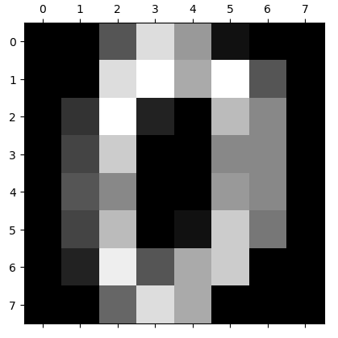
The Hand-Written Digits Dataset
The hand-written digits dataset will be used in the hands-on labs.
The dataset consists of 1797 observations, each representing a processed image of a hand-written digit.
The images were processed to be 8x8 pixels in grayscale. Here’s an example:
Each observation in the dataset has a total of 64 features.
Each feature has a value of 0 to 16, representing the intensity of color.
The data set has approximately 180 observations for each digit 0 to 9.
Class labels for each observation are provided.
Notes:
More information about scikit-learn’s support for the hand-written digits dataset is available via the online documentation:
https://scikit-learn.org/stable/modules/generated/sklearn.datasets.load_digits.html
https://scikit-learn.org/stable/datasets/toy_dataset.html#digits-dataset

Slide 13
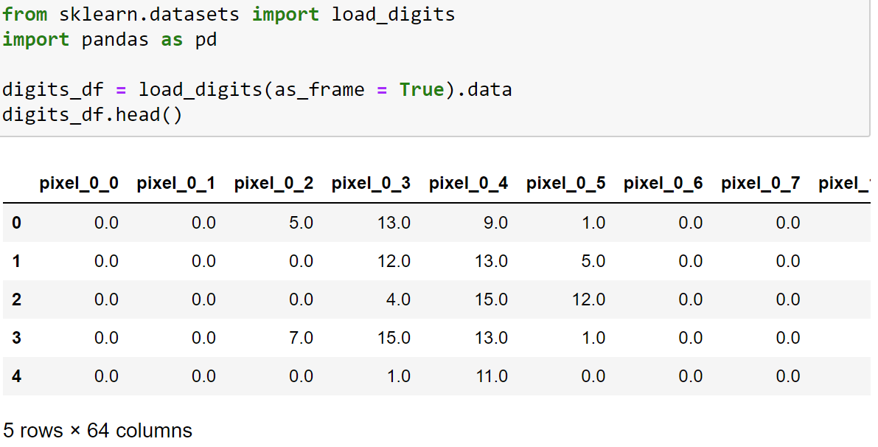
The Hand-Written Digits Dataset
The hand-written digits dataset is available via the scikit-learn library:
Notes:
More information about scikit-learn’s support for the hand-written digits dataset is available via the online documentation:
https://scikit-learn.org/stable/modules/generated/sklearn.datasets.load_digits.html
https://scikit-learn.org/stable/datasets/toy_dataset.html#digits-dataset

Slide 14
The Heart Dataset
Later in the course, we will cover how to cluster data that contains both numeric and categorical features.
We will use the Statlog (Heart) dataset in both lecture and labs:
Feature | Type | Categorical Levels
HeartDisease | Categorical | Class label. Value of 1 if heart disease is present, 0 otherwise
Age | Numeric
Male | Categorical | Value of 1 if male, 0 otherwise
ChestPainType | Categorical | Chest pain type. Values are 1 thru 4
BloodPressure | Numeric
Cholesterol | Numeric
BloodSugar | Categorical | Value of 1 if fasting blood sugar > 120 mg/dl
EEG | Categorical | Values of 0 thru 2
MaxHR | Numeric
Angina | Categorical | Value of 1 if angina induced, 0 otherwise
OldPeak | Numeric
PeakST | Numeric
Flourosopy | Numeric
Thal | Categorical | 3 = normal; 6 = fixed defect; 7 = reversable defect
Notes:
More information on the Statlog (Heart) dataset is available via the UCI Machine Learning Repository website:
https://archive.ics.uci.edu/ml/datasets/statlog+(heart)

Slide 15
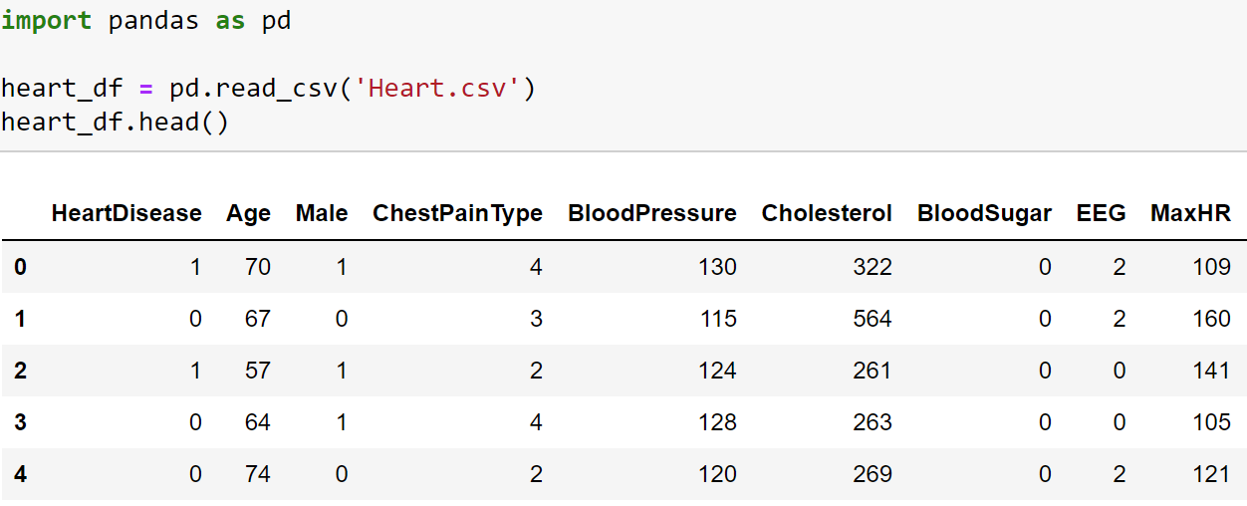
The Heart Dataset
The heart dataset consists of 270 observations:

Slide 16
Types of Clusterings & Clusters
Section 3
Notes:
An entire collection of clusters is referred to as a clustering.

Slide 17
Hierarchical
Hierarchical clustering allows for clusters to be nested:
Hierarchical clusters are often visualized using a tree:
Cluster 1
Cluster 2
Cluster 5
Cluster 3
Cluster 4
Cluster 6
Cluster 7
Cluster 1
Cluster 2
Cluster 5
Cluster 3
Cluster 6
Cluster 4
Cluster 7
Agglomerative clustering is a bottom-up approach to building the hierarchy.
Divisive clustering is a top-down approach to building the hierarchy.
Notes:
Hierarchical clustering is typically used when a taxonomical data structure is to be uncovered. For example, using hierarchical clustering with a collection of documents could discover clusters that group the documents into ever more-specific topic groups as you move down the hierarchy.
Hierarchical clustering algorithms are typically implemented using one of the following approaches:
Agglomerative clustering: This is a bottoms-up approach where the lowest clusters of the tree are discovered first. From there, nearby clusters are combined to form the next level up. This process is continued until only one cluster remains at the top of the tree.
Divisive clustering: This is a top-down approach where the data is recursively split into subclusters until only single data points remain.
In practice, agglomerative clustering is used far more than divisive clustering.

Slide 18
Partitional
Partitional clustering divides the data into non-overlapping groups (clusters).
The most common applications of cluster analysis use partitional clustering techniques.
Cluster 2
Cluster 1
Cluster 3

Slide 19
Overlapping
Overlapping clustering allows data points to be part of one or more groups (clusters).
Overlapping clustering allows for many real-world scenarios.
For example, David Langer was once simultaneously a Microsoft employee, shareholder, and customer.
Cluster 1
Cluster 2
Cluster 3

Slide 20
Complete vs. Partial
Complete clustering ensures that every data point is assigned to a cluster:
Partial clustering will leave data points unassigned to clusters – typically to improve the clusters:
Unassigned

Slide 21
Well-Separated Clusters
Clusters are well-separated when a data point within a cluster is closer to all cluster members than any data points that are members of other clusters.
Not well-separated!
Well-separated

Slide 22
Prototype Clusters
A prototype cluster is built around a representative data point that usually does not exist in the original data.
Members of a cluster are closer to the cluster’s prototype than any other cluster prototypes.
When clustering numeric data, the prototype is often calculated using the average (mean) of all cluster member data.
In these cases, the prototype is called a centroid.
Prototype clusters are commonly used when clusters are spherically shaped.
Centroid
Centroid

Slide 23
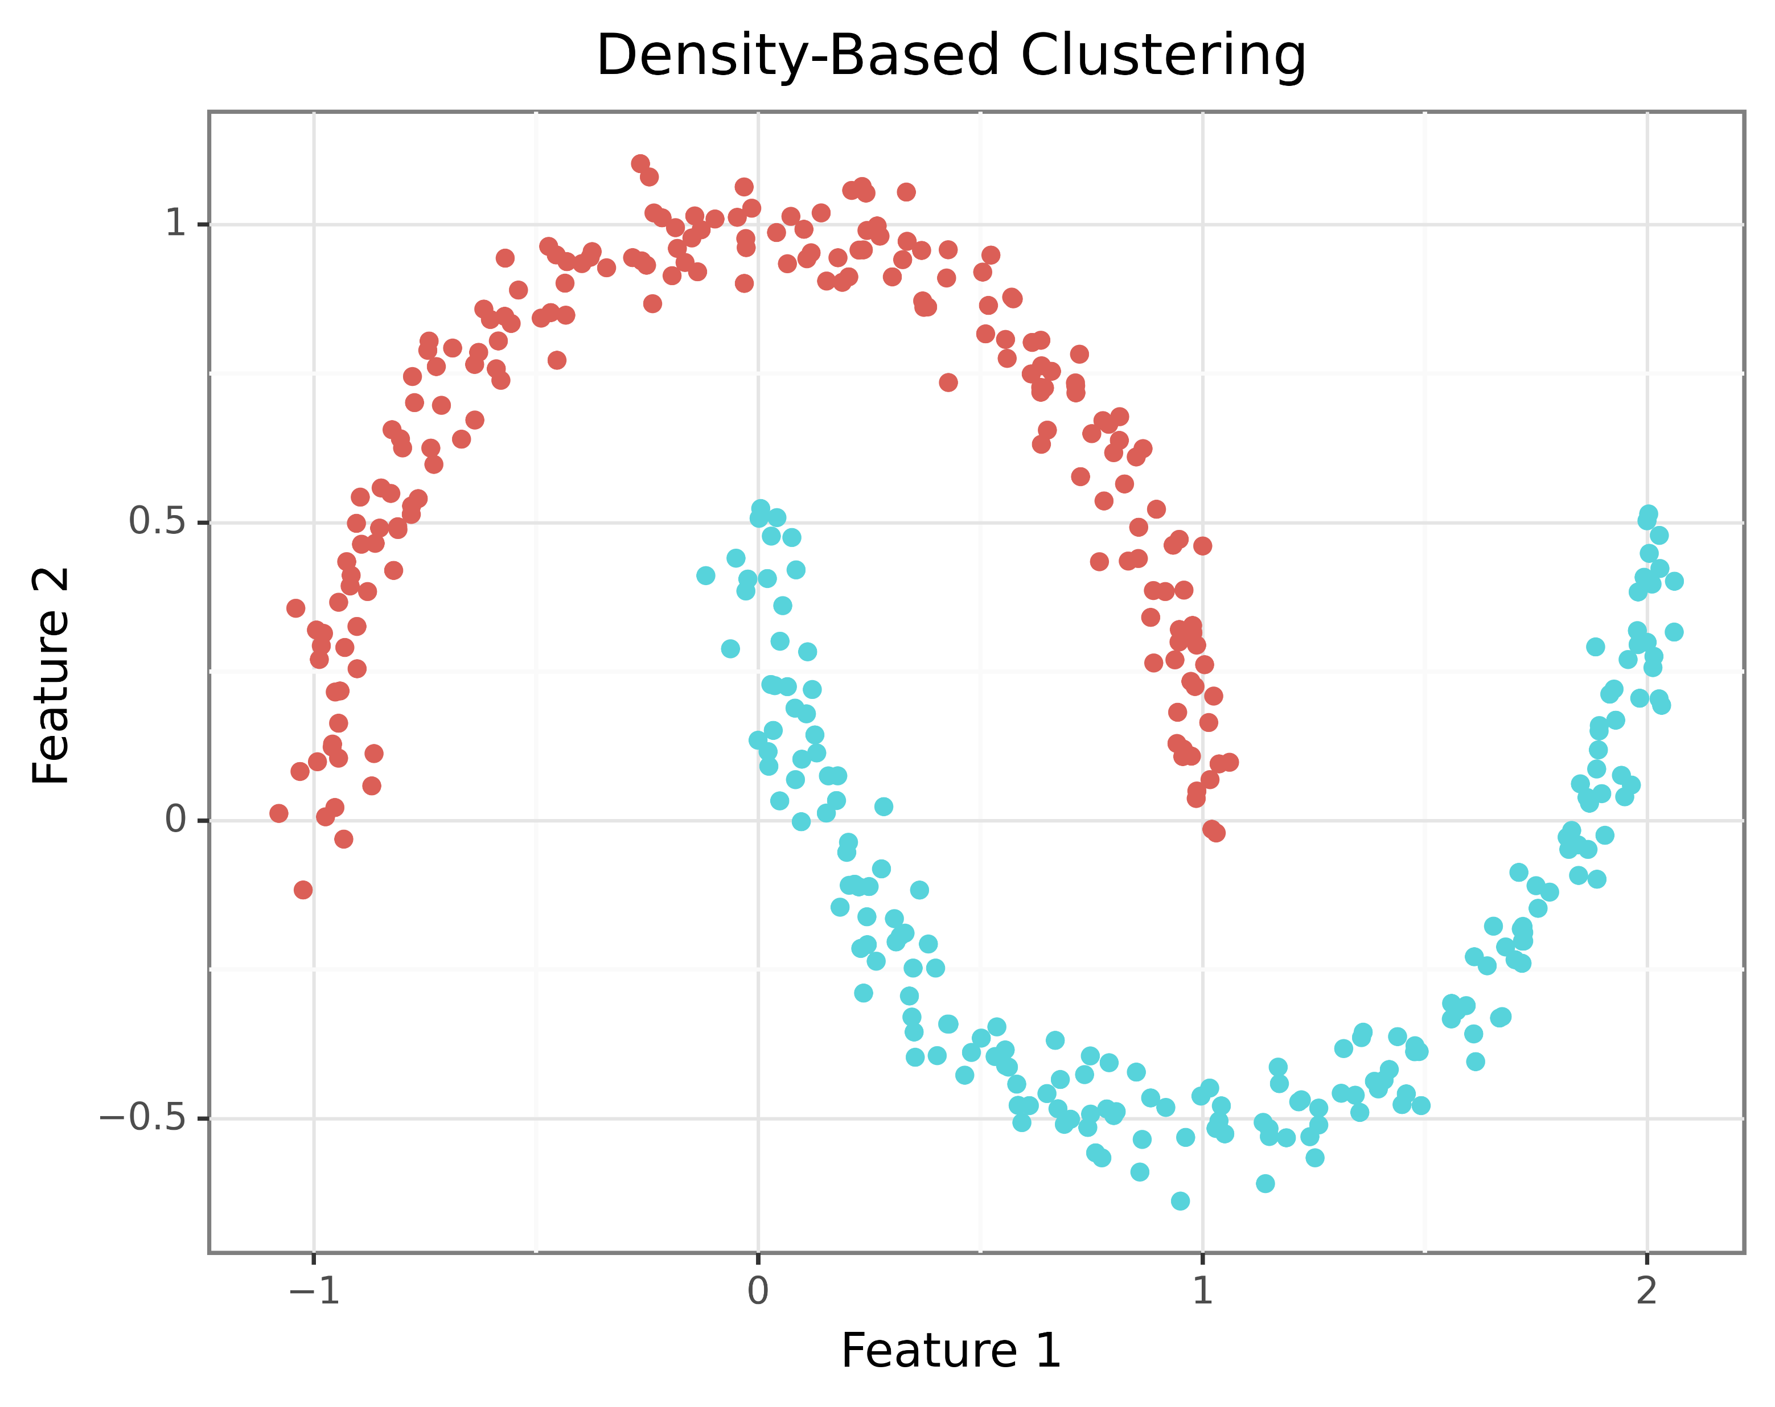
Density-Based Clusters
Density-based clusters are regions dense with data points surrounded by regions with a low density of data points.
Density-based clusters are used when clusters are irregular (e.g., not spherical), intertwined, and/or when outliers are present.
In practice, it is hard to know the shape of clusters due to the use of many features making visualization impossible.
As such, it is common to try multiple clustering techniques and compare results.
High Density
Low Density
High Density

Slide 24
K-Means
Section 4

Slide 25
Introducing K-Means
The k-means algorithm is a prototype-based, complete partitioning clustering technique.
Whew! That was a mouthful.
Let’s break that down:
K-means uses centroids based on the average data of cluster members
The clusters produced by k-means are spherical
Every data point is assigned to a cluster – even outliers
Every data point will be assigned to a single cluster
K-means is one of the most popular clustering techniques.
A big part of k-means’ popularity is the algorithm’s simplicity – it is easy to understand how k-means works intuitively.
Notes:
For more information on k-means, check out the Wikipedia article:
https://en.wikipedia.org/wiki/K-means_clustering

Slide 26
The K-Means Algorithm
“In mathematics and computer science, an algorithm is a finite sequence of rigorous instructions, typically used to solve a class of specific problems or to perform a computation. Algorithms are used as specifications for performing calculations and data processing.” - Wikipedia
Here’s the k-means algorithm:
Select k points as the initial cluster centroids
Form k clusters by assigning each data point to its closest centroid
Recompute each centroid as the average of all current cluster members
Stop if no centroid changes, otherwise go to 2
Notice that the first step requires you to pick k – the number of clusters to be found.
Turns out that picking the right value for k is a non-trivial problem.
We’re going to cover that in the next section of the course.
Notes:
Check out the full Wikipedia article here:
https://en.wikipedia.org/wiki/Algorithm

Slide 27
A Contrived Example
“Obvious cluster”
Consider a hypothetical dataset that needs to be clustered. To keep things simple, there are only two numeric features in the dataset.
For this contrived example, we’ll assume that we know ahead of time from business subject matter experts that there should be two clusters in the data.
As such, we’ll choose k = 2.
Watch this data point
“Obvious cluster”

Slide 28
Random Start
Centroid 0
K-means needs someplace to start working with the data.
Once the number of clusters is chosen, k-means “throws out” some random cluster centers (i.e., centroids) as a starting point.
Centroid 1
Notes:
Due to the usage of a random start, the k-means algorithm is non-deterministic. This means you will not necessarily get the same results each time k-mean is executed with your data. In practice, it is common to run k-means many times with the same value for k.
NOTE – Python begins counting at 0, not 1!

Slide 29
Assign Data to Clusters
Closest to centroid 0
K-means then looks at each “point” (e.g., documents) to cluster in turn:
What’s the distance from the point to centroid 0?
What’s the distance from the point to centroid 1?
Closest to centroid 1

Slide 30
Assign Data to Clusters
Based on proximity, k-means then assigns each data point to a cluster.

Slide 31
Move Clusters
Average the cluster 0 values
Moving the centroids is where the name “k-means” comes from.
Centroids are moved based on the average values of the data points within the cluster.
Average the cluster 0 values
Notes:
NOTE – The “mean” is the same thing as the “average.”

Slide 32
Move Clusters
Average the cluster 0 values
Moving the centroids is where the name “k-means” comes from.
Centroids are moved based on the average values of the data points within the cluster.
Average the cluster 0 values

Slide 33
Move Clusters
The moving process is repeated for each centroid.
Average the cluster 1 values
Average the cluster 1 values

Slide 34
Move Clusters
Whoa!
Average the cluster 1 values
Average the cluster 1 values
Notes:
Notice on this slide how the cluster 2 center has been pulled farther up the y-axis than expected based on the bulk of the data. The k-means algorithm is sensitive to outliers, causing the cluster center to move farther than one would expect. When using k-means, it is a common practice to standardize/normalize the data before clustering.

Slide 35
Move Clusters
K-means is an iterative process (i.e., algorithm).
The process is repeated until a stopping condition is reached.
What about this data?

Slide 36
Assign Data To Clusters
K-means looks at each “point” (i.e., document) to cluster in turn:
What’s the distance from the point to centroid 0?
What’s the distance from the point to centroid 1?
New cluster assignment

Slide 37
Move Clusters
Average the cluster 0 values
Average the cluster 0 values
The centroids are again moved based on the new point-to-cluster assignments.
Average the cluster 1 values
Average the cluster 1 values

Slide 38
Move Clusters & Stopping Condition
The k-means algorithm stops when no data points are assigned to a new cluster.

Slide 39
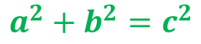
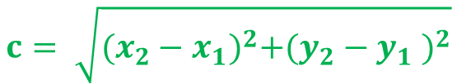
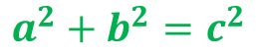
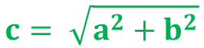
What is “Close”?
K-means is most used with a calculation known as Euclidean distance.
While it sounds complicated, it really isn’t.
Set the way back machine to intro geometry. Remember the Pythagorean theorem?
$$a^{2}+b^{2}=c^{2}$$
$$a^{2}+b^{2}=c^{2}$$
$$c= \sqrt{a^{2}+b^{2}}$$
$$c= \sqrt{{(x_{2}−x_{1})}^{2}+{(y_{2}−y_{1} )}^{2}}$$
c
c
b
b = y₂ – y₁
a
a = x₂ – x₁
Notes:
While Euclidian distance is depicted here using only two dimensions, the calculation scales to any number of dimensions.

Slide 40
Distance Example
Feature 1 | Feature 2 | Feature 3
3.5 | 7.8 | 2.3
Let’s say you had this data point running through k-means:
With 2 centroids:
Here are the Euclidean distance calculations:
Feature 1 | Feature 2 | Feature 3
1.2 | 4.1 | 5.1
2.7 | 9.4 | 3.6
$$Distance=\sqrt{{({feature1}_{2}−{feature1}_{1})}^{2}+{({feature2}_{2}−{feature2}_{1})}^{2}+{({feature3}_{2}−{feature3}_{1})}^{2}}$$
$${Distance}_{centroid 0}=\sqrt{{(1.2−3.5)}^{2}+{(4.1−7.8)}^{2}+{(5.1−2.3)}^{2}} =5.1788$$
$${Distance}_{centroid 1}=\sqrt{{(2.7−3.5)}^{2}+{(9.4−7.8)}^{2}+{(3.6−2.3)}^{2}} =2.2113$$
Assign to cluster 1
Notes:
You can think of the Pythagorean theorem as Euclidean distance in two dimensions (i.e., two features). To accommodate more than two dimensions, you repeat the pattern of the square of the difference between each feature.

Slide 41
The Problem with Outliers
The k-means algorithm uses the average (i.e., the mean) to calculate new centroid locations.
The k-means algorithm also performs complete clustering – every data point is assigned to a cluster.
When there are outlier data points to be clustered, the new centroid locations are influenced by the outliers.
Let’s say you had these data points assigned to a cluster:
Distance | Weight | Volume
126 | 7.8 | 2.3
123 | 8.1 | 3.4
300 | 8.6 | 2.9
Feature 1 | Feature 2 | Feature 3
183 | 8.17 | 2.87
K-means would calculate the new centroid location to be:
The centroid is skewed by Distance!
Notes:
It is also worthy to note that the distances calculated for all the data points will be much larger due to Distance being a different measurement scale compared to Weight and Volume.

Slide 42
Standardizing the Data
To prevent undue influence of outliers on k-means clustering, it is standard practice to standardize the data prior to clustering.
The goal of standardizing the data is to transform features so that they have the same unit of measurement.
The most common form of standardization is known as the Z-score:
Calculate the mean of all feature values
Calculate the standard deviation of all feature values
Subtract the mean from each feature value
Divide by the standard deviation
Another common form of standardization is the term frequency-inverse document frequency (TF-IDF) calculation when clustering documents.
The scikit-learn library provides classes to perform both of these standardization calculations.
Notes:
For more information on the Z-score and TF-IDF, check out the scikit-learn online documentation:
https://scikit-learn.org/stable/modules/preprocessing.html#preprocessing-scaler
https://scikit-learn.org/stable/modules/feature_extraction.html#text-feature-extraction

Slide 43
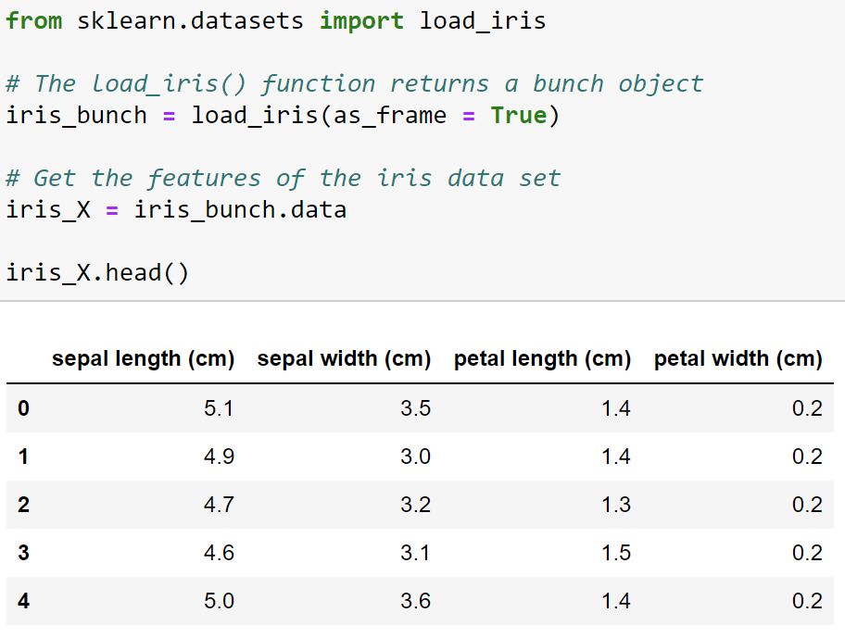
K-Means with Python

Slide 44
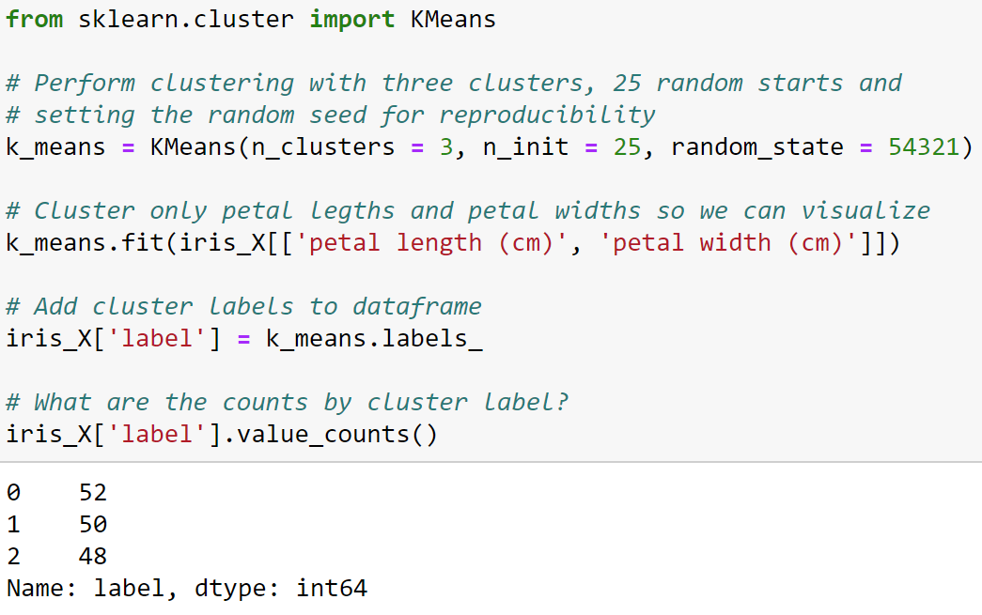
K-Means with Python
Notes:
In practice, cluster analysis can be guided by subject matter expertise. For example, specifying the number of clusters based on business knowledge. We are simulating this scenario here as we know there are three classes in the iris dataset. The feature values of the iris dataset are all on the same scale and do not have outliers. As such, standardization isn’t necessary to get good clustering results. A later slide will demonstrate standardizing the iris dataset using the Z-score.
NOTE: The KMeans class does not use truly randomized starting centroids by default. Instead, it uses an optimized approach called “kmeans++”. More information can be found via the online documentation:
https://scikit-learn.org/stable/modules/generated/sklearn.cluster.KMeans.html

Slide 45
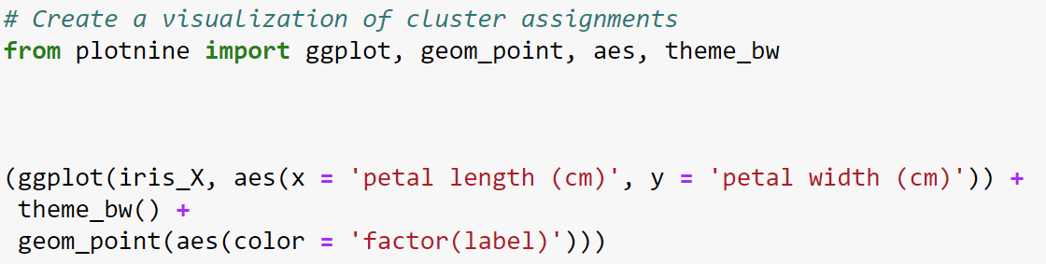
Visualizing Clusters
Import plotnine functions
Build the plot
Using this data
Map features to the x-axis and y-axis
Make plot black & white
Color each point by cluster assignment
Build a scatter plot
Notes:
The code in this slide uses the plotnine library which implements the Grammar of Graphics in Python. More information can be found at the plotnine website:
https://plotnine.readthedocs.io/
The code also takes advantage of Python method chaining – which is why the code is wrapped in ().

Slide 46
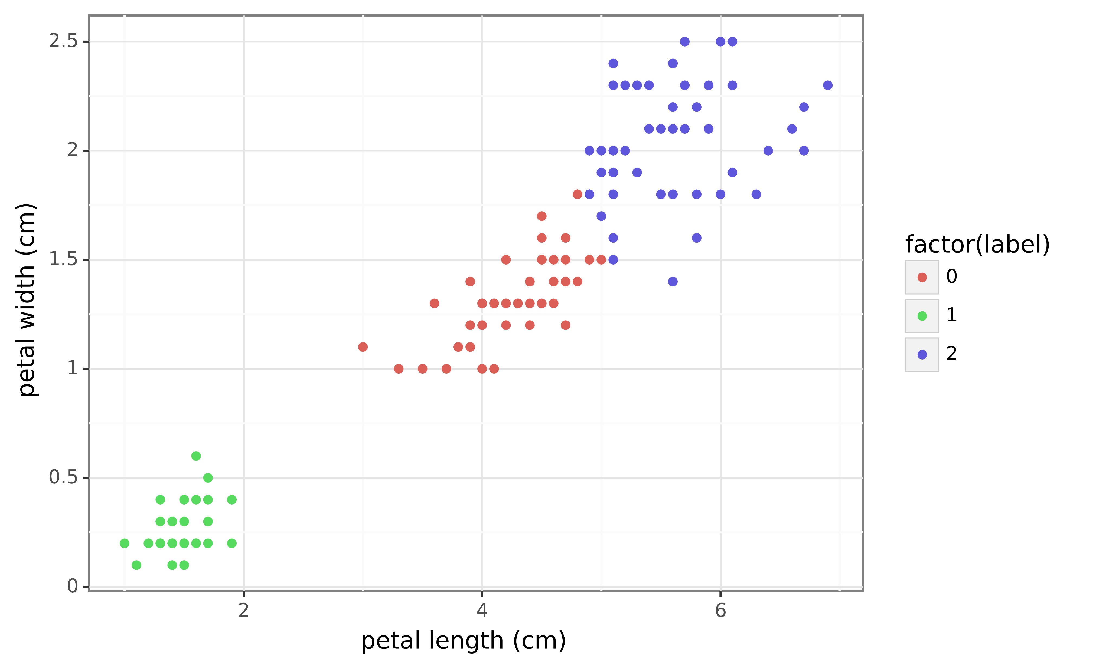
K-Means Clustering Results
Notes:
On initial inspection, the clusters appear to be well-formed. Without any additional information (e.g., comparing to the actual labels), this would be a good result in practice.

Slide 47
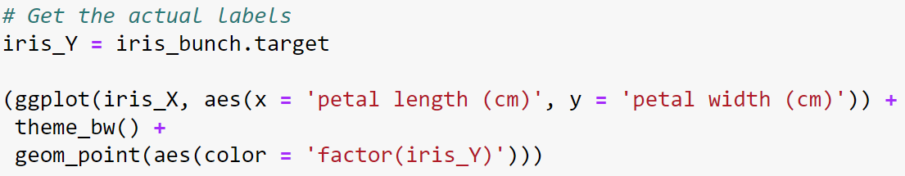
Iris Ground Truth

Slide 48
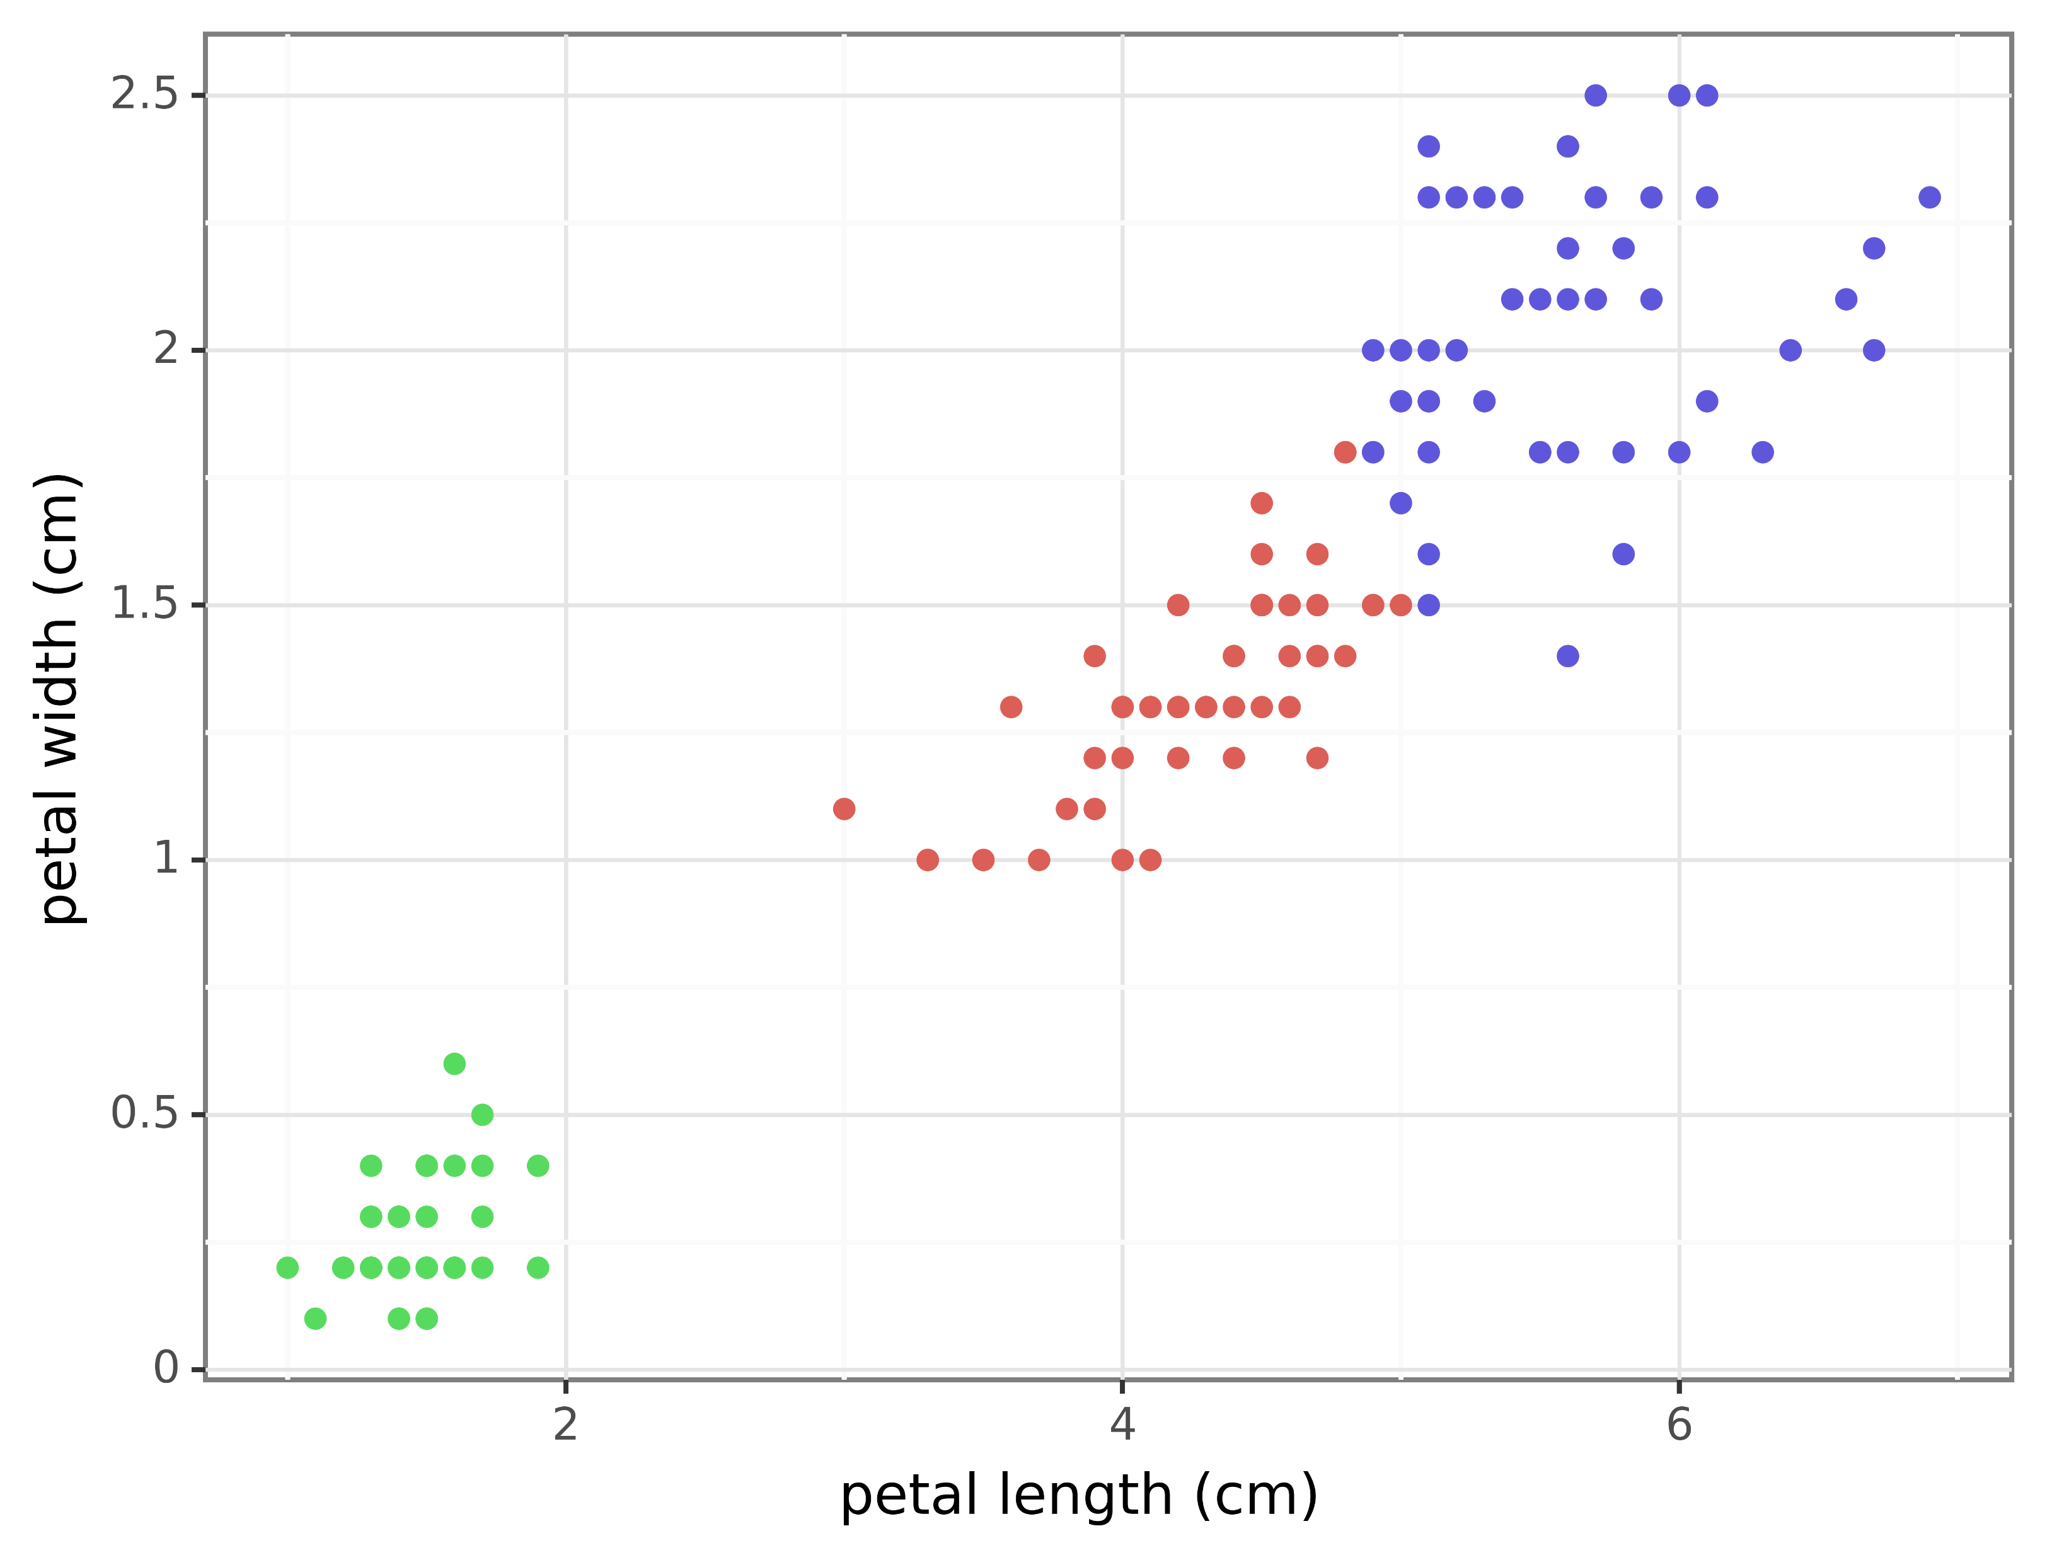
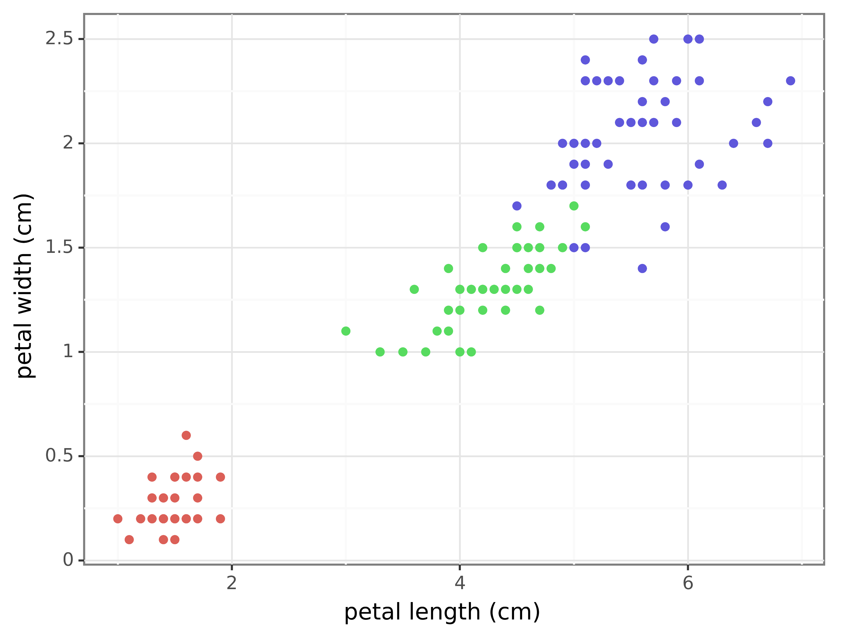
Evaluating Clusters
K-means clusters
Actual clusters
Notes:
As demonstrated by this slide, clusters are rarely perfect. It should be noted that this clustering is quite good given that only two of the four features were used. It is possible that the clustering would improve if more features were used.

Slide 49
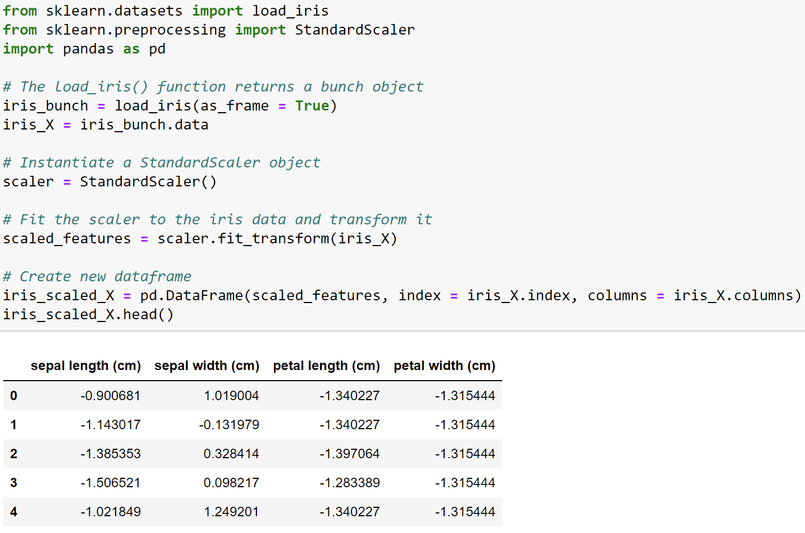
Standardizing Data
Notes:
The StandardScaler class from the scikit-learn library can be used to standardize data using the Z-score. More information on the class is available via the online documentation:
https://scikit-learn.org/stable/modules/generated/sklearn.preprocessing.StandardScaler.html
A couple of things to note:
The StandardScaler class should be used on numeric features only
The StandardScaler class returns a numpy array, not a pandas DataFrame

Slide 50
K-Means Caveats
K-means requires the number of clusters to be chosen by the data analyst:
Relying on subject matter expertise to determine the value of k
The scree plot elbow method
The average silhouette score
Given the random starting points, k-means is a non-deterministic clustering technique:
Best practice is to run k-means multiple times with the same k and evaluate clusters across runs
If you need reproducibility, be sure to set the random seed
The Euclidian distance calculation technically only works with numeric data (i.e., non-categorical):
We’ll cover techniques for handling categorical data later in the course
K-means only produces “clouds” of clustered data points:
If the natural shape of the clusters is irregular, k-means is a less effective method
Notes:
When the natural shape of clusters are irregular, density-based clustering techniques like DBSCAN can be more effective. We’ll cover DBSCAN later in the course.

Slide 51
Hands-on Lab #1
Notes:
Here is the easiest way to get going with the lab:
Start Anaconda Navigator
Within Anaconda Navigator, start Jupyter Notebook
Using the browser, navigate to where the course files are located on your computer
Click on the “Hands-On Lab 1 – K-Means.ipynb” listing in the browser window

Slide 52
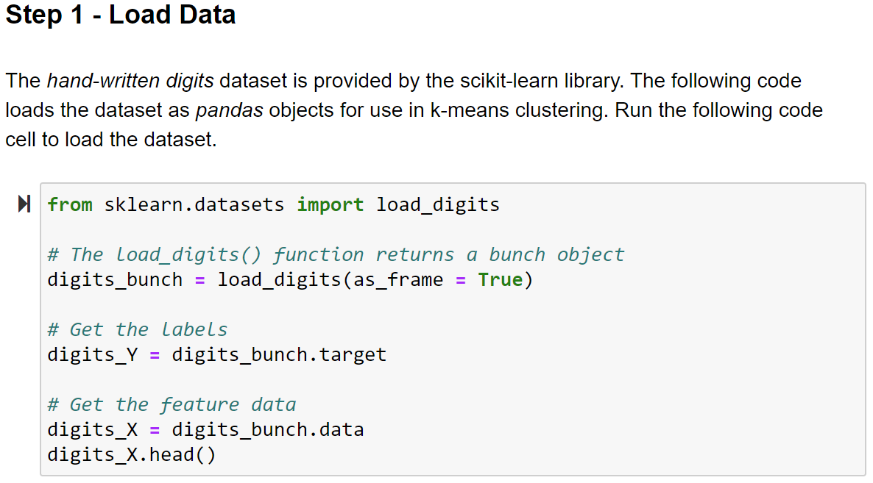
Notes:
The scikit-learn library uses the following naming convention that aligns with classic modeling techniques (e.g., OLS linear regression):
X: This is typically a pandas dataframe or numpy array/matrix of the features used in modeling techniques like k-means. Also called the independent variables.
Y: This is typically a pandas dataframe or numpy array of the label (or target). Also called the dependent variable.

Slide 53
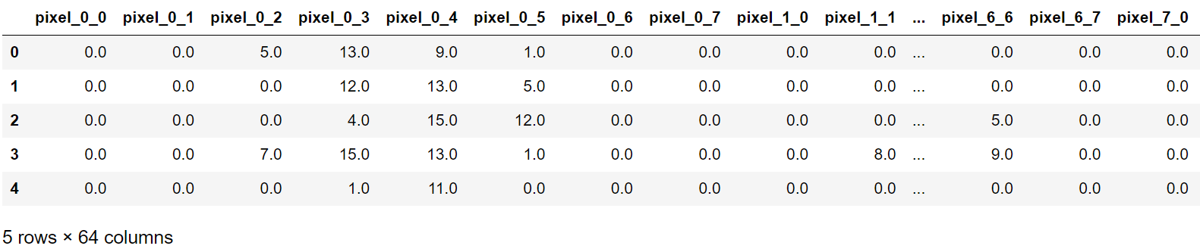
Row 0 pixels
Output from Step 1
Notes:
The output above shows the feature naming convention for the hand-written digits data set:
All feature names starting with “Pixel_0” correspond to the first row of pixels in the image

Slide 54
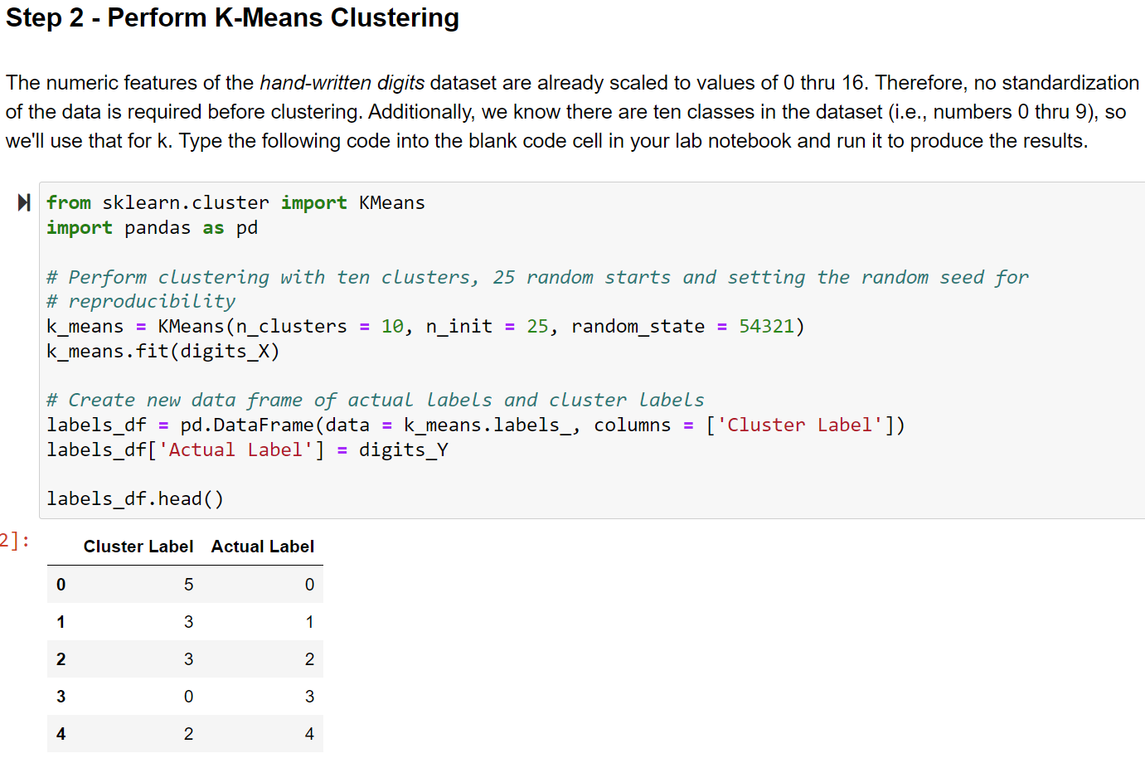
Notes:
In the output above notice how the cluster label of 3 aligns to the actual labels of 1 and 2 for two observations. This is an example of why learning cluster analysis using labeled data is helpful – you get insight into the imperfections common in clustering algorithms. As you progress through the lab, you will get more insight into how well k-means clusters the hand-written digits dataset.

Slide 55
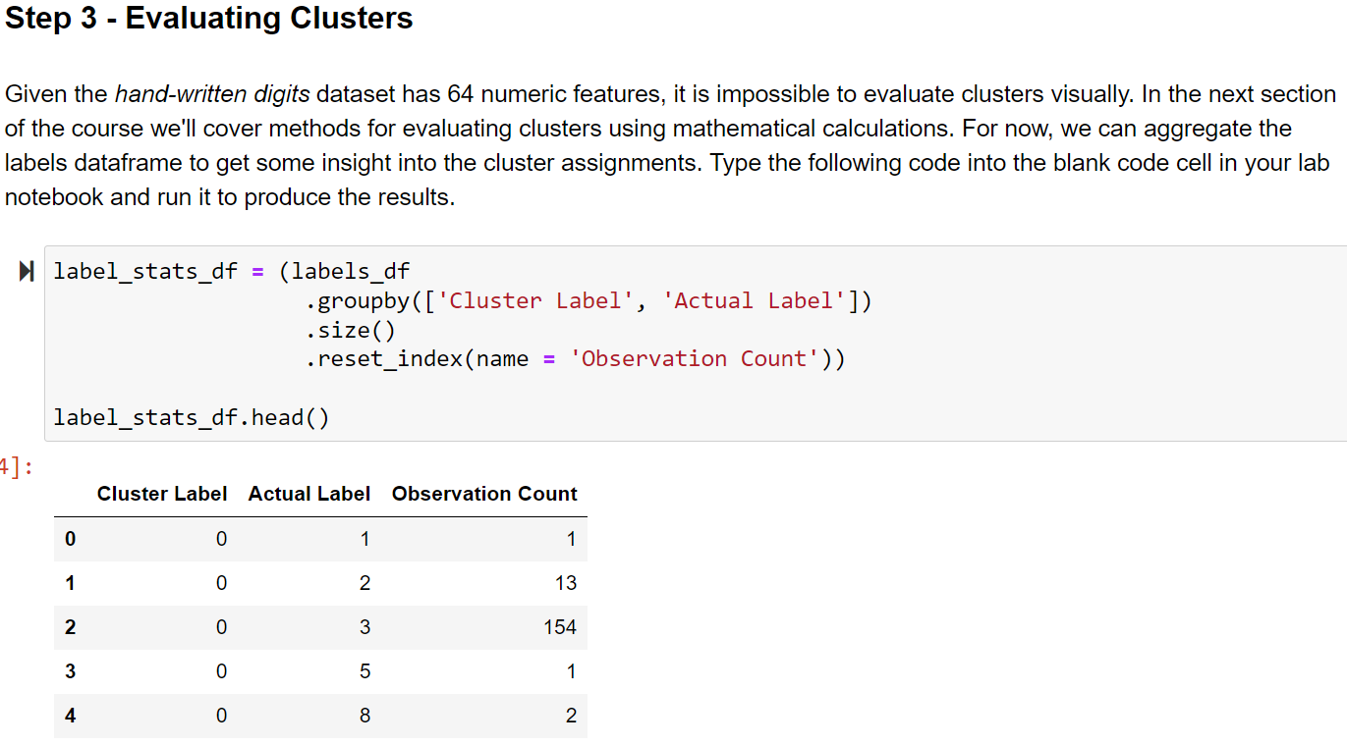
Notes:
The code above uses the pandas groupby() method to create a pivot of the data using the combination of cluster and actual labels. The goal of the pivot is to provide insight into the effectiveness of the clustering. Looking in the output above, we can see that the cluster label 0 is most highly aligned with the actual label of 3. However, there are a total of 17 other observations included in the cluster where the actual label is not 3.

Slide 56
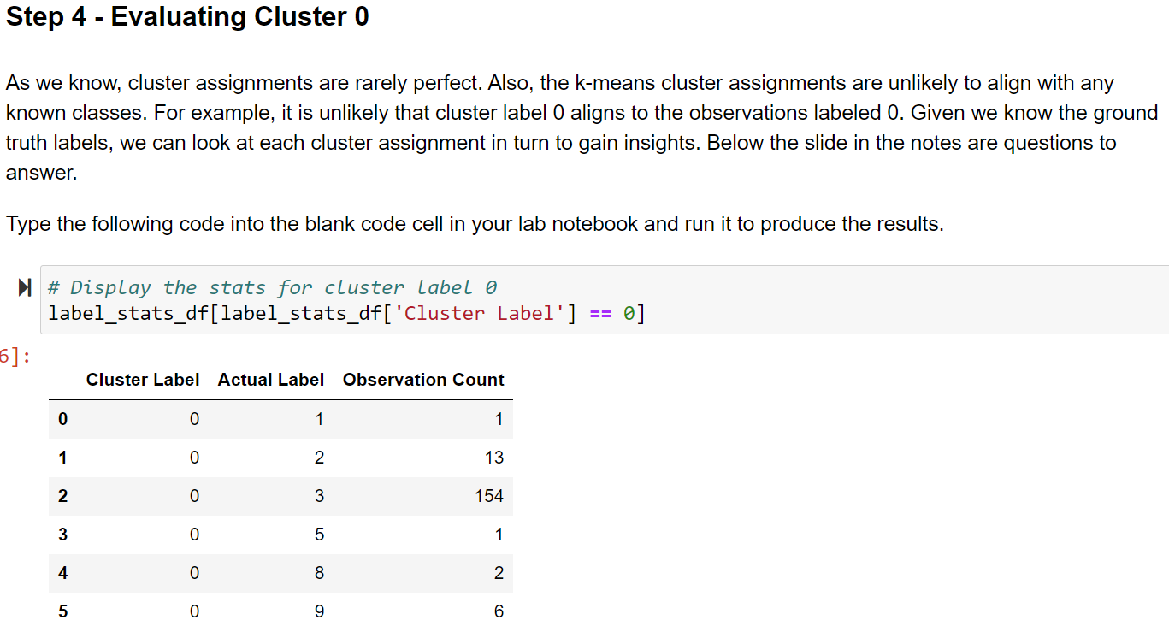
Notes:
In looking at the table above, answer the following questions:
Does the cluster label 0 align to more than a single actual label? If so, how many actual labels does it align to?
Does the cluster label 0 align disproportionately to any actual label? If so, which label?
Based on the answer to the questions above:
Which digit does cluster label 0 best align to?
How would you assess the overall quality of this cluster?

Slide 57
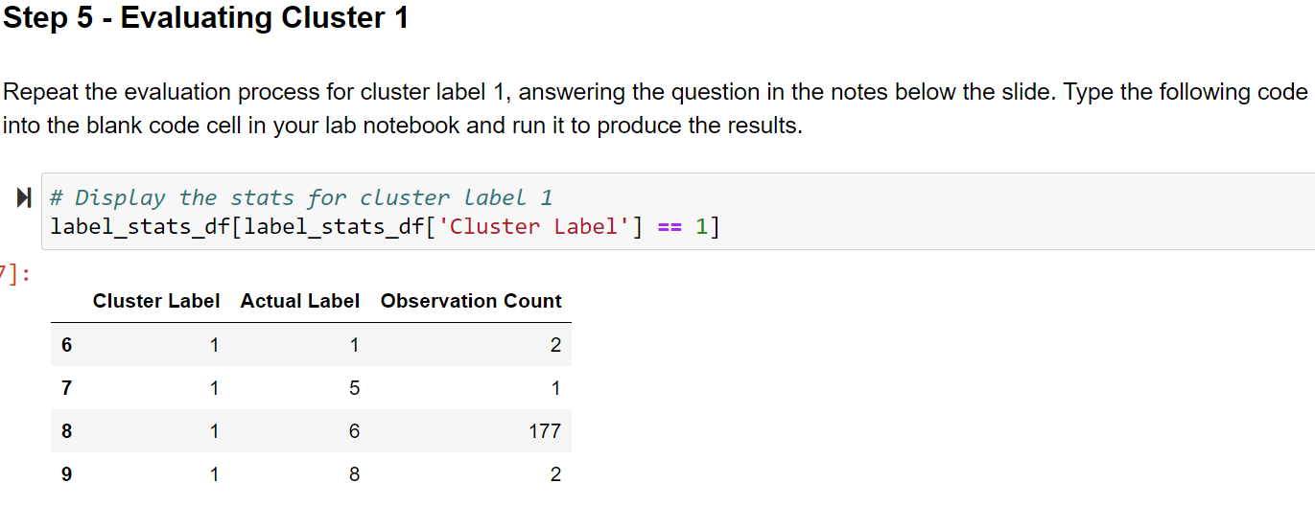
Notes:
NOTE – Be sure to reuse your code via copy-and-paste and changing the cluster label number from 0 to 1.
In looking at the table above, answer the following questions:
Does the cluster label 1 align to more than a single actual label? If so, how many actual labels does it align to?
Does the cluster label 1 align disproportionately to any actual label? If so, which label?
Based on the answer to the questions above:
Which digit does cluster label 1 best align to?
How would you assess the overall quality of this cluster?

Slide 58
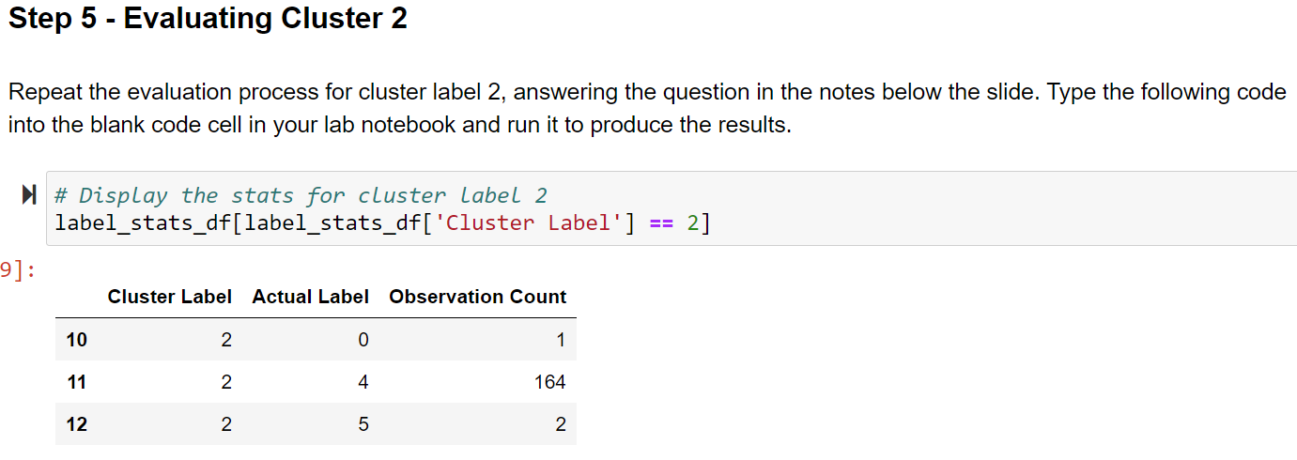
Notes:
NOTE – Be sure to reuse your code via copy-and-paste and changing the cluster label number.
In looking at the table above, answer the following questions:
Does the cluster label 2 align to more than a single actual label? If so, how many actual labels does it align to?
Does the cluster label 2 align disproportionately to any actual label? If so, which label?
Based on the answer to the questions above:
Which digit does cluster label 2 best align to?
How would you assess the overall quality of this cluster?

Slide 59
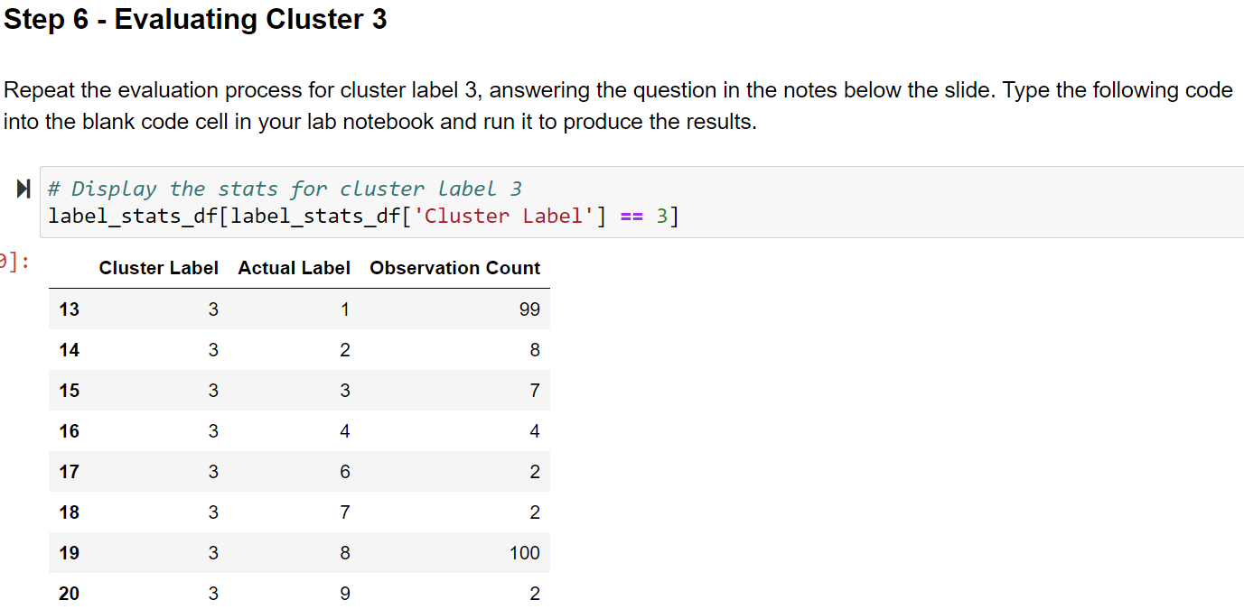
Notes:
NOTE – Be sure to reuse your code via copy-and-paste and changing the cluster label number.
In looking at the table above, answer the following questions:
Does the cluster label 3 align to more than a single actual label? If so, how many actual labels does it align to?
Does the cluster label 3 align disproportionately to any actual label? If so, which label?
Based on the answer to the questions above:
Which digit does cluster label 3 best align to?
How would you assess the overall quality of this cluster?

Slide 60
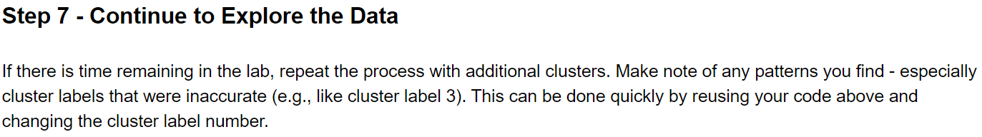
Notes:
In looking at the table above, answer the following questions:
Does the cluster label X (e.g., 4, 5, or 6) align to more than a single actual label? If so, how many actual labels does it align to?
Does the cluster label X (e.g., 4, 5, or 6) align disproportionately to any actual label? If so, which label?
Based on the answer to the questions above:
Which digit does cluster label X (e.g., 4, 5, or 6) best align to?
How would you assess the overall quality of this cluster?

Slide 61
Optimizing K-Means
Section 5
Notes:
In this section of the course, we’ll consider optimizing k-means as using heuristics (“rules of thumb”) for identifying the optimal number of clusters based on the data alone (i.e., there are no class labels present in the data).

Slide 62
Evaluating Clusters
The first step in optimizing k-means is understanding what characterizes one clustering as better than another.
The concepts of cohesion and separation are critical. In terms of k-means:
Cohesion is the sum of proximities of each data point to its assigned centroid
Separation is the proximity between any two centroids
These concepts can be represented graphically:
Cohesion
There exists an important relationship between cohesion and separation.
As cohesion improves (i.e., gets smaller), separation improves (i.e., gets larger).
Optimizing k-means uses this relationship.
Separation

Slide 63
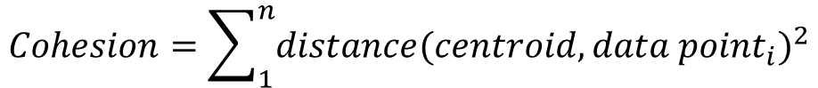
Calculating Cohesion
The k-means algorithm most commonly uses Euclidian distance.
If cohesion is defined as the sum of the squared distances between a centroid and all cluster points:
$$Distance=\sqrt{{({f1}_{2}−{f1}_{1})}^{2}+{({f2}_{2}−{f2}_{1})}^{2}+…+{({fn}_{2}−{fn}_{1})}^{2}}$$
$$Cohesion=\sum_{1}^{n}{distance(centroid, {data point}_{i})^{2}}$$
Turns out that making the centroid the average of the cluster data points minimizes cohesion and improves separation!
By summing all the cohesions for all clusters, we can arrive at a metric for the overall quality of a clustering.
We can optimize k-means by iterating through increasing values of k and monitoring changes to the sum of cohesion for each value of k.
Notes:
The definition of cohesion used above is also known as the sum of squared errors (SSE). Conceptually, the calculation is assuming that any difference between the positions of a centroid and data point is an “error.”
The mathematical proof of the above beyond the scope of the course. For more information on this subject, consult the following book:
“Introduction to Data Mining” by Pang-Ning, Michael Steinbach, and Vipin Kumar, first edition May 2, 2005.

Slide 64
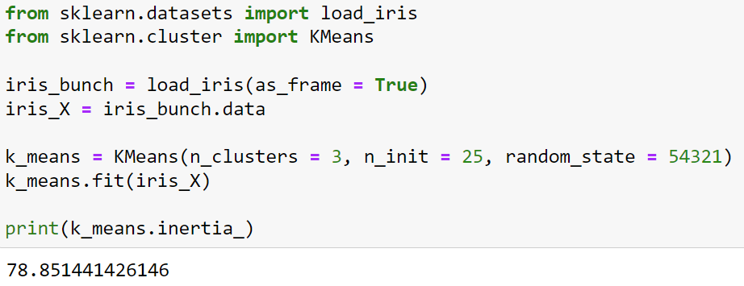
Evaluating Cohesion with Python
The Python KMeans class calculates and stores total cohesion for a clustering via the inertia_ attribute:

Slide 65
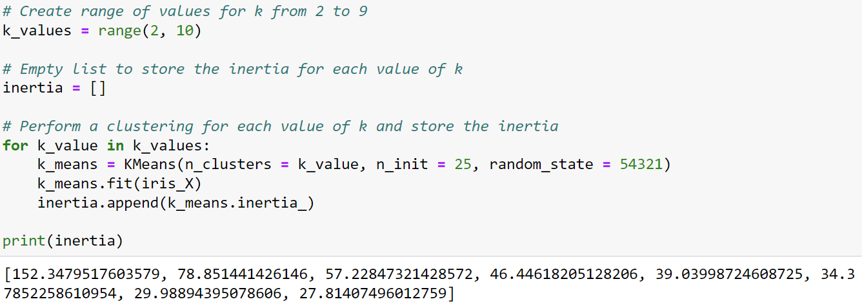
Evaluating Cohesion with Python
The Python KMeans class calculates and stores total cohesion for a clustering via the inertia_ attribute:
Notes:
NOTE – The code on this slide assumes the code from the previous slide has been run.

Slide 66
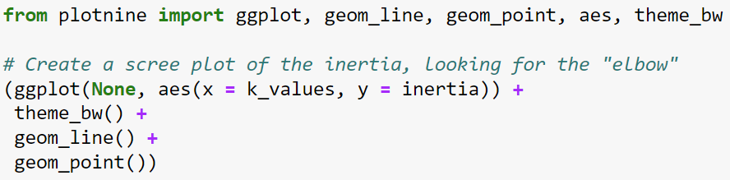
The Elbow Method
We can use the inertias calculated from the previous slide for what is known as the elbow method.
The fundamental idea of the elbow method is to find the point of diminishing returns (i.e., the “elbow”) as the optimal value.
Finding the point of diminishing returns is typically accomplished using a scree plot.
With k-means, we can plot the inertia as a function of the k value:
Build the plot
Make plot black & white
Map values to x-axis and y-axis
Add a line and points
Notes:
NOTE:
The code on this slide assumes the code from the previous slide has been run.
The code above uses “None” in the call to the ggplot function because individual objects (i.e., k_values and inertia) as opposed to a pandas DataFrame are being used.

Slide 67
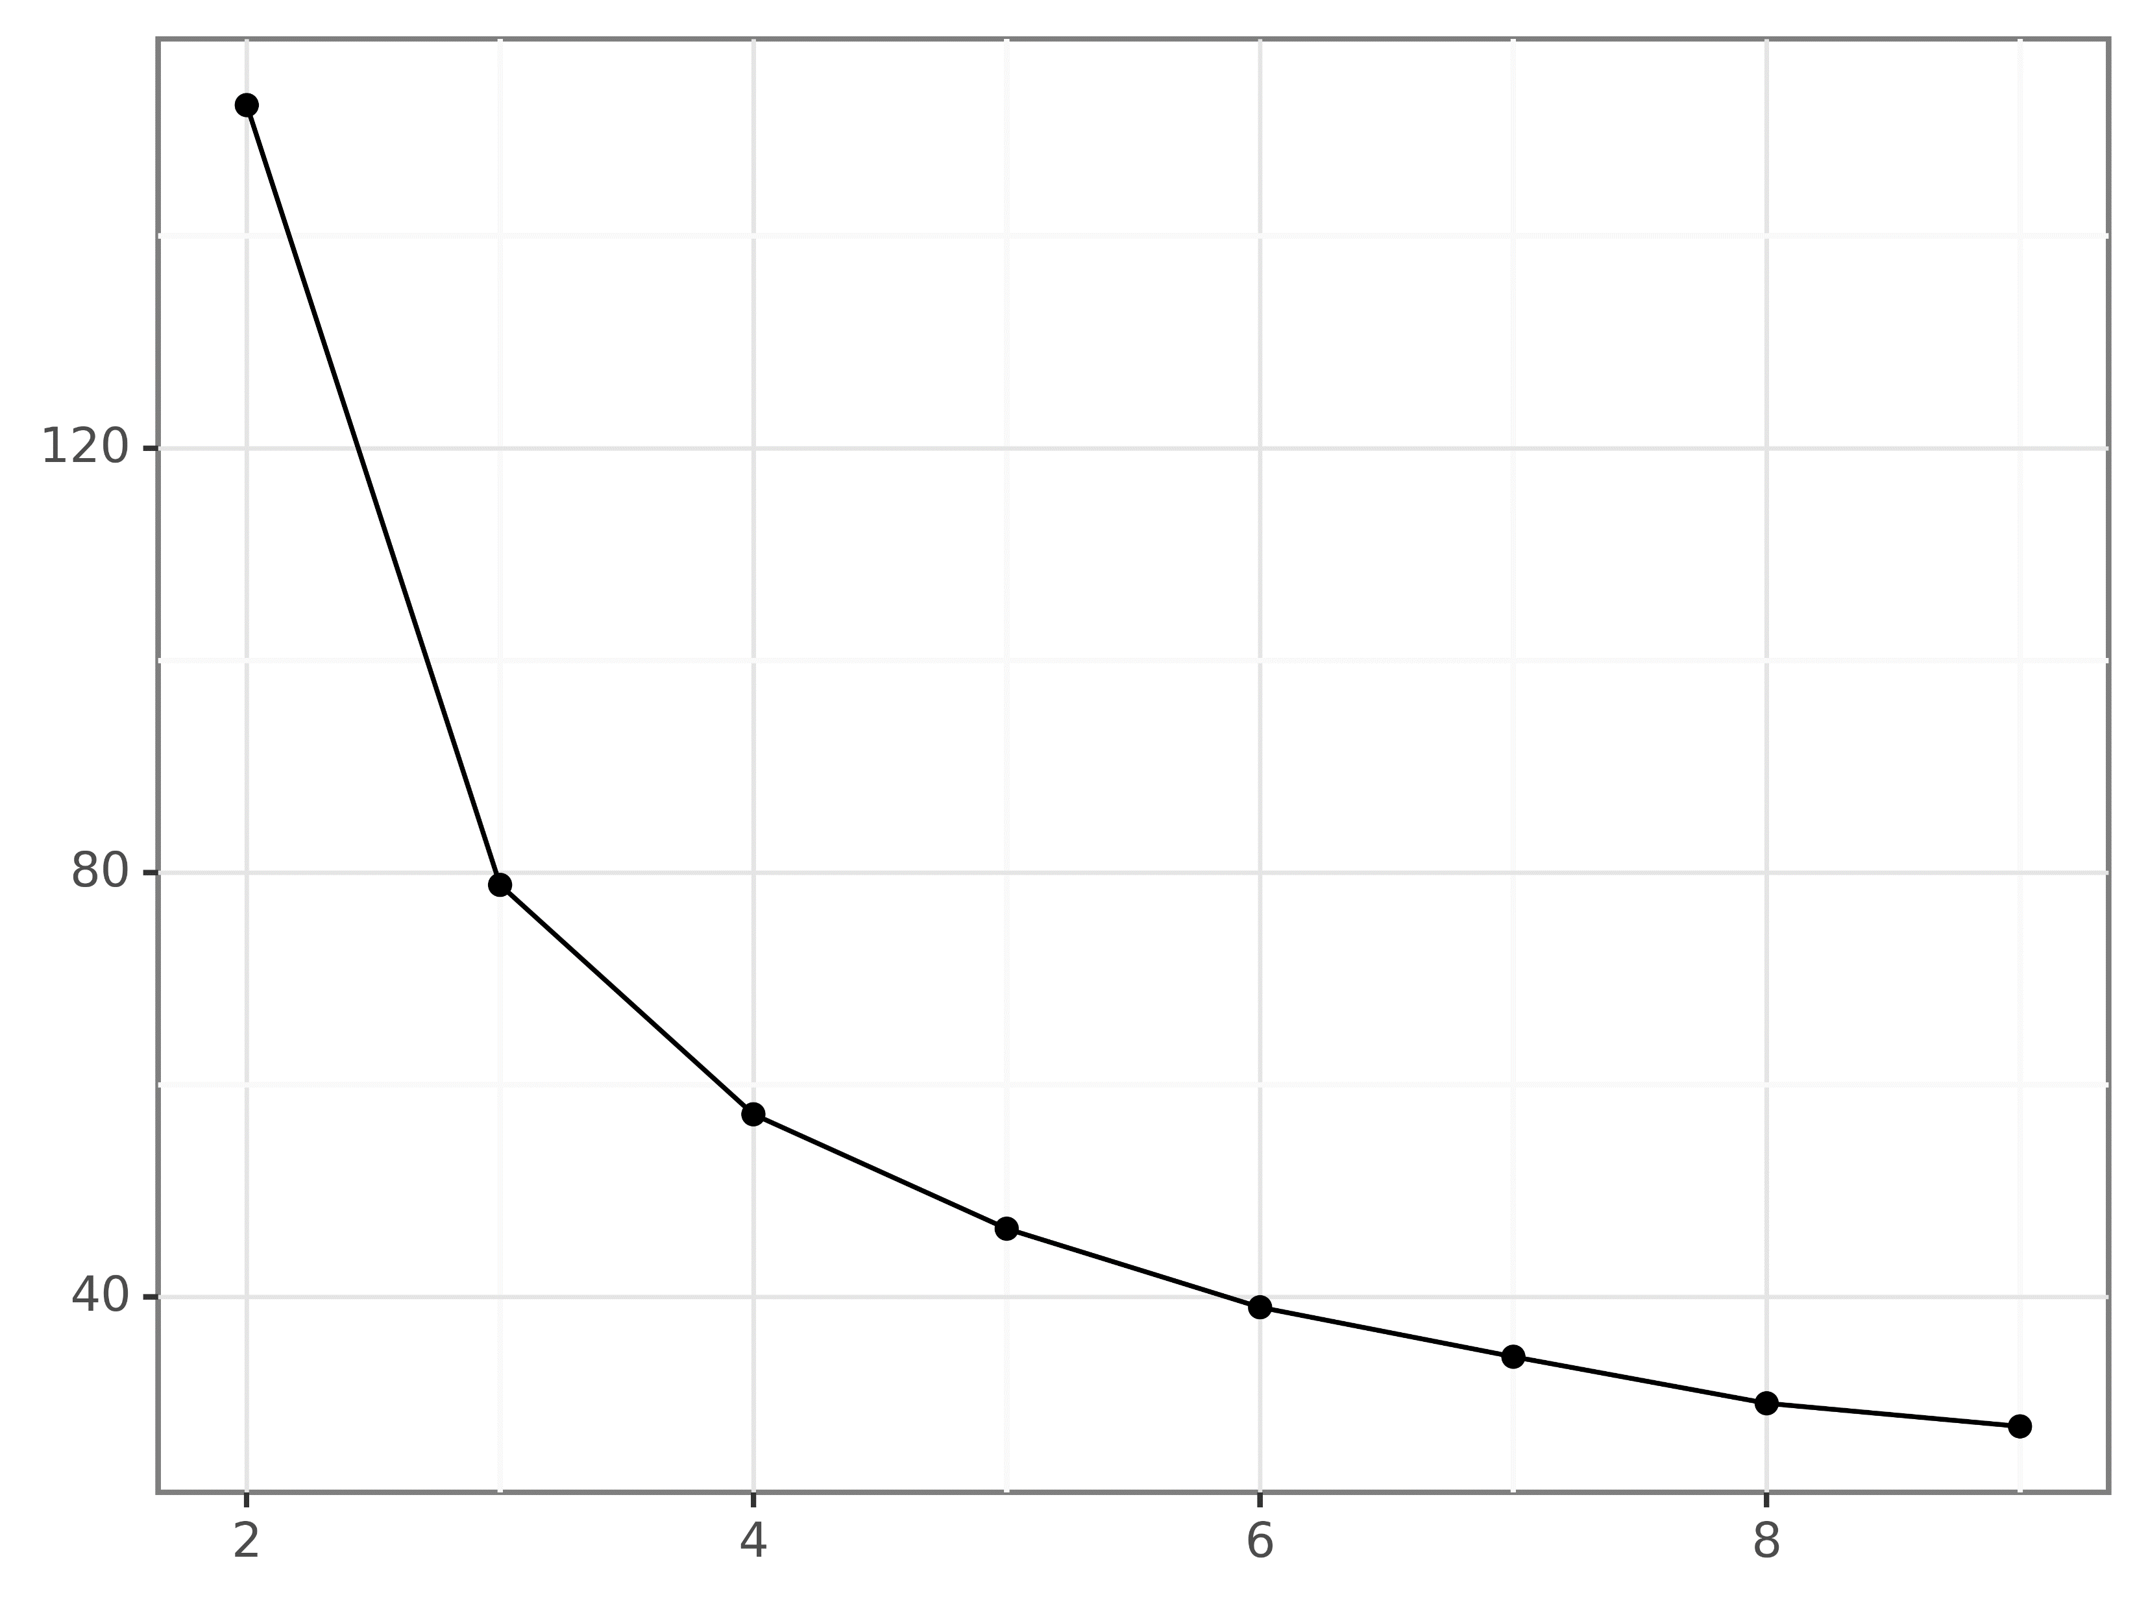
The Elbow Method
The “elbow”
k = 4!
What!?
Notes:
This scree plot is a perfect example of how the elbow method is a heuristic – choosing the point of the “elbow” is subjective. For more information on the elbow method, check out the following Wikipedia article:
https://en.wikipedia.org/wiki/Elbow_method_(clustering)

Slide 68
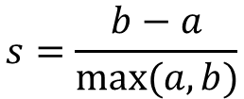
The Silhouette Coefficient
Another popular method of optimizing k-means is the silhouette coefficient.
While the inertia elbow method relies on cohesion alone to find an optimal value for k, the silhouette coefficient uses both cohesion and separation.
Calculating the silhouette coefficient for a single data point starts with two calculations:
a: The mean distance between a data point and all other points in the same cluster
b: The mean distance between a data point and all other points in the next nearest cluster
Using these calculations, the silhouette coefficient for a data point is:
The silhouette coefficient ranges from -1 to 1:
Negative values correspond to a point that is closer on average to a different cluster
Positive values correspond to clusters with very strong cohesion
$$s=\frac{b−a}{max⁡(a, b)}$$

Slide 69
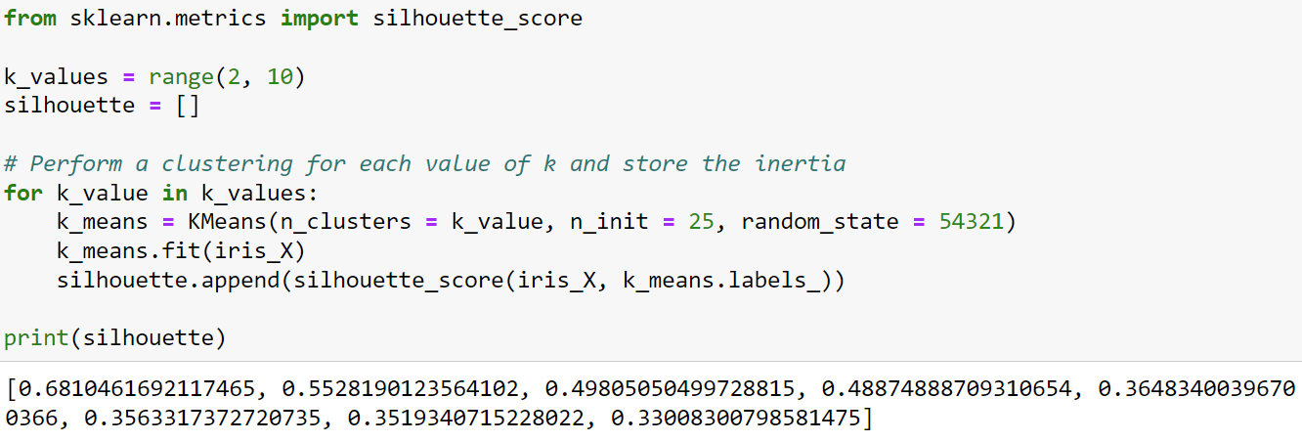
The Silhouette Score
A clustering can be evaluated by calculating the silhouette coefficient for every data point and taking the average of all coefficients – the silhouette score:

Slide 70
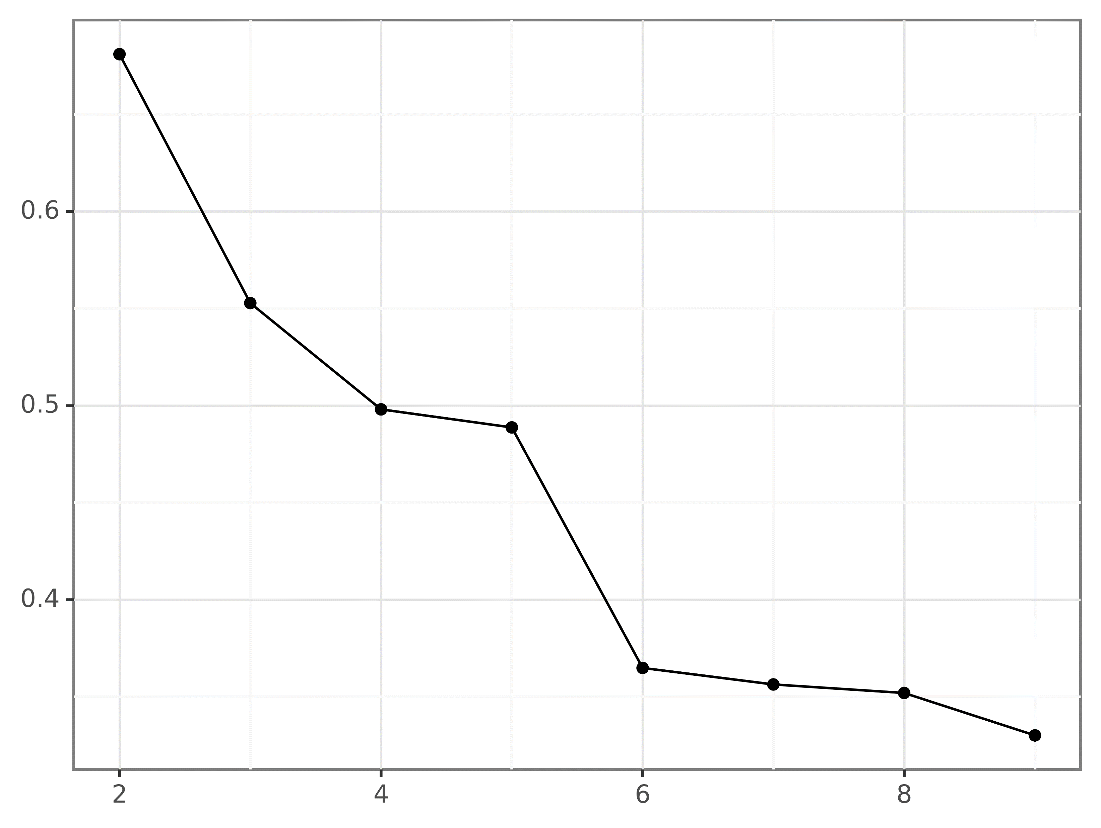
The Silhouette Score
Highest silhouette score
k = 2!
What!?
Notes:
Like the inertia elbow method, the silhouette score is not guaranteed to find the perfect value for k.

Slide 71
Better Together
Inertia elbow method
Silhouette Score
Reasonable choices
k = 2, k = 3
Reasonable choices
k = 3, k = 4
Best choice is k = 3

Slide 72
Hands-on Lab #2
Notes:
Here is the easiest way to get going with the lab:
Start Anaconda Navigator
Within Anaconda Navigator, start Jupyter Notebook
Using the browser, navigate to where the course files are located on your computer
Click on the “Hands-On Lab 2 – Optimizing K-Means.ipynb” listing in the browser window

Slide 73
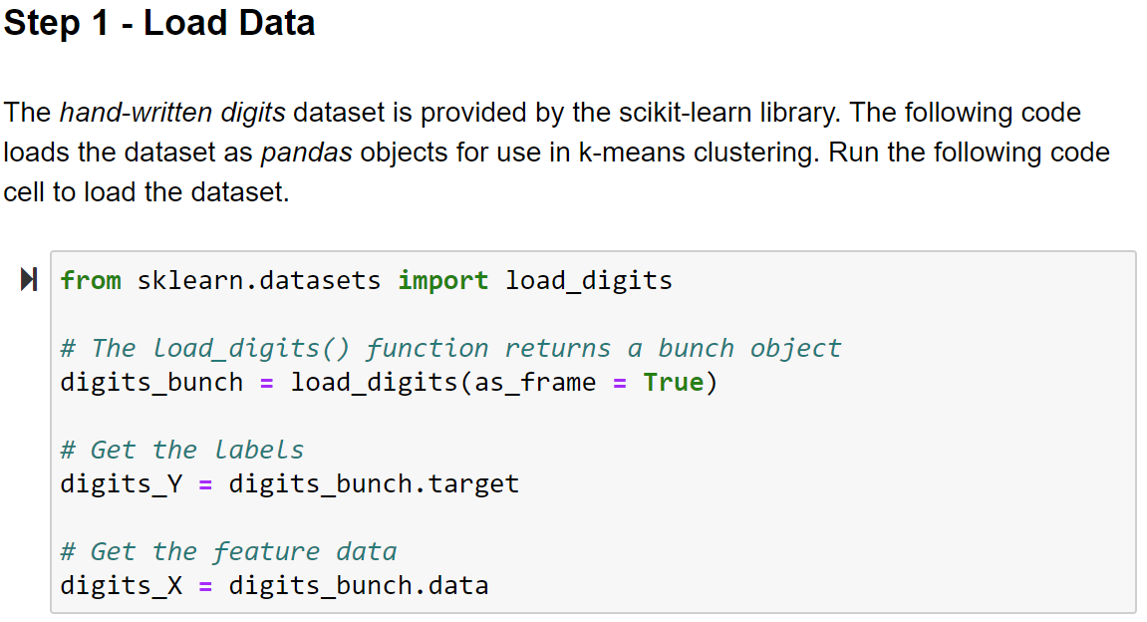

Slide 74
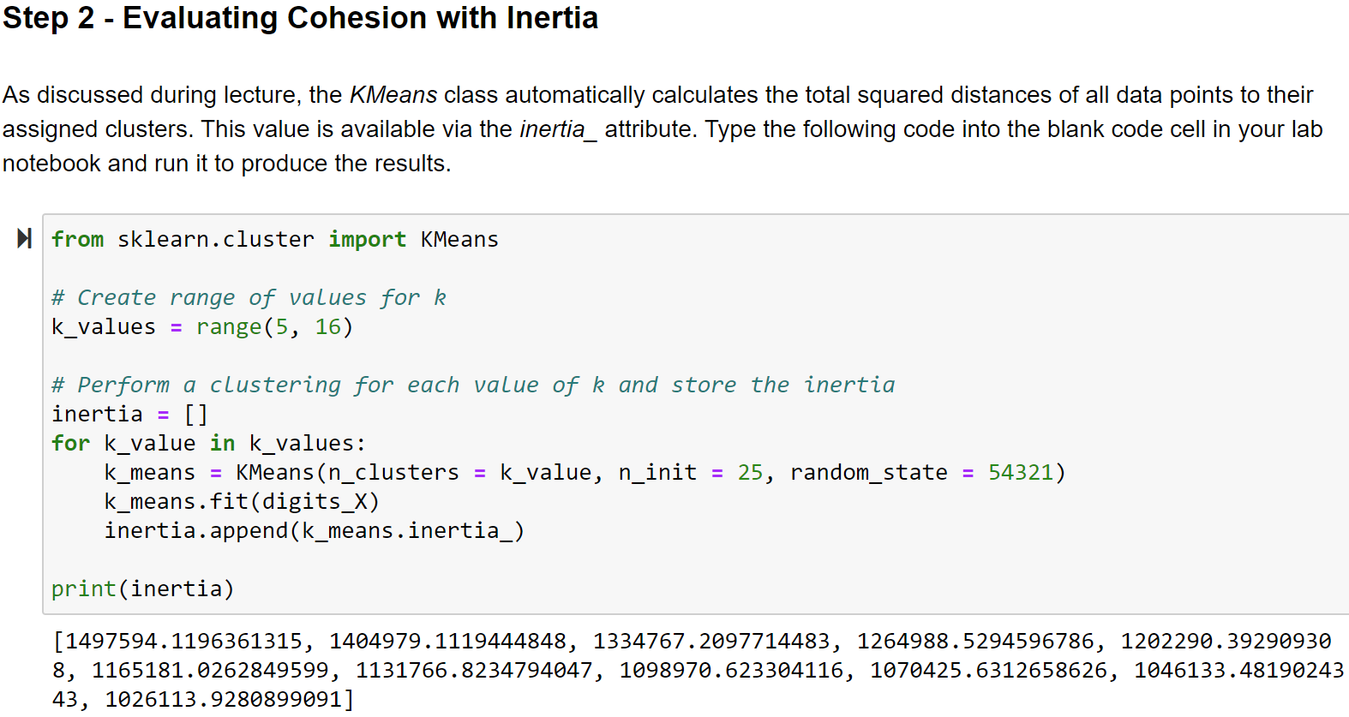
Notes:
The code above performs a total of 11 k-means cluster analyses using values of k ranging from 5 to 15 and ensuring reproducibility by setting the random seed to the same value for each clustering. As discussed in lecture, the inertia calculation is based solely on cluster cohesion. When optimizing k-means with inertia the key idea is that improving cluster cohesion (i.e., lowering inertia) improves cluster separation.

Slide 75
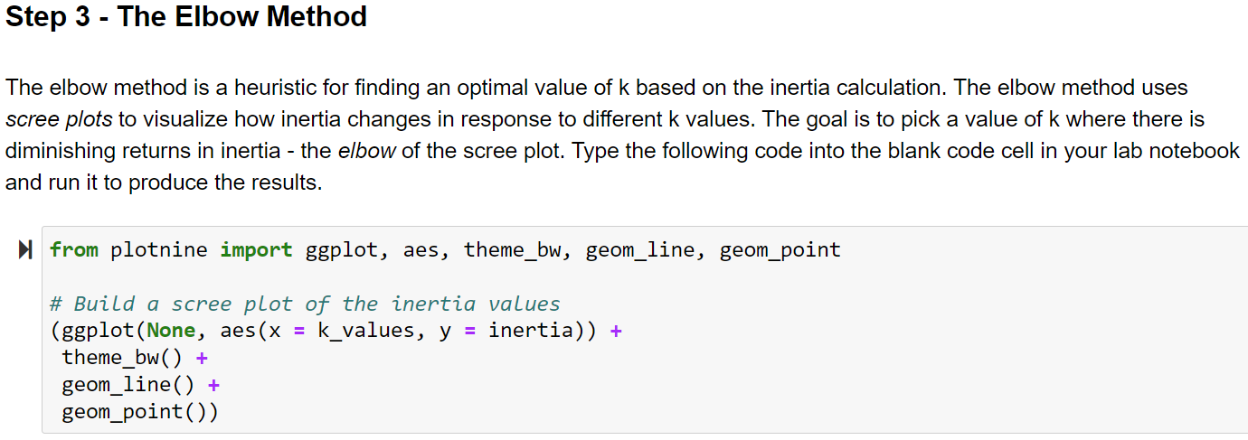

Slide 76
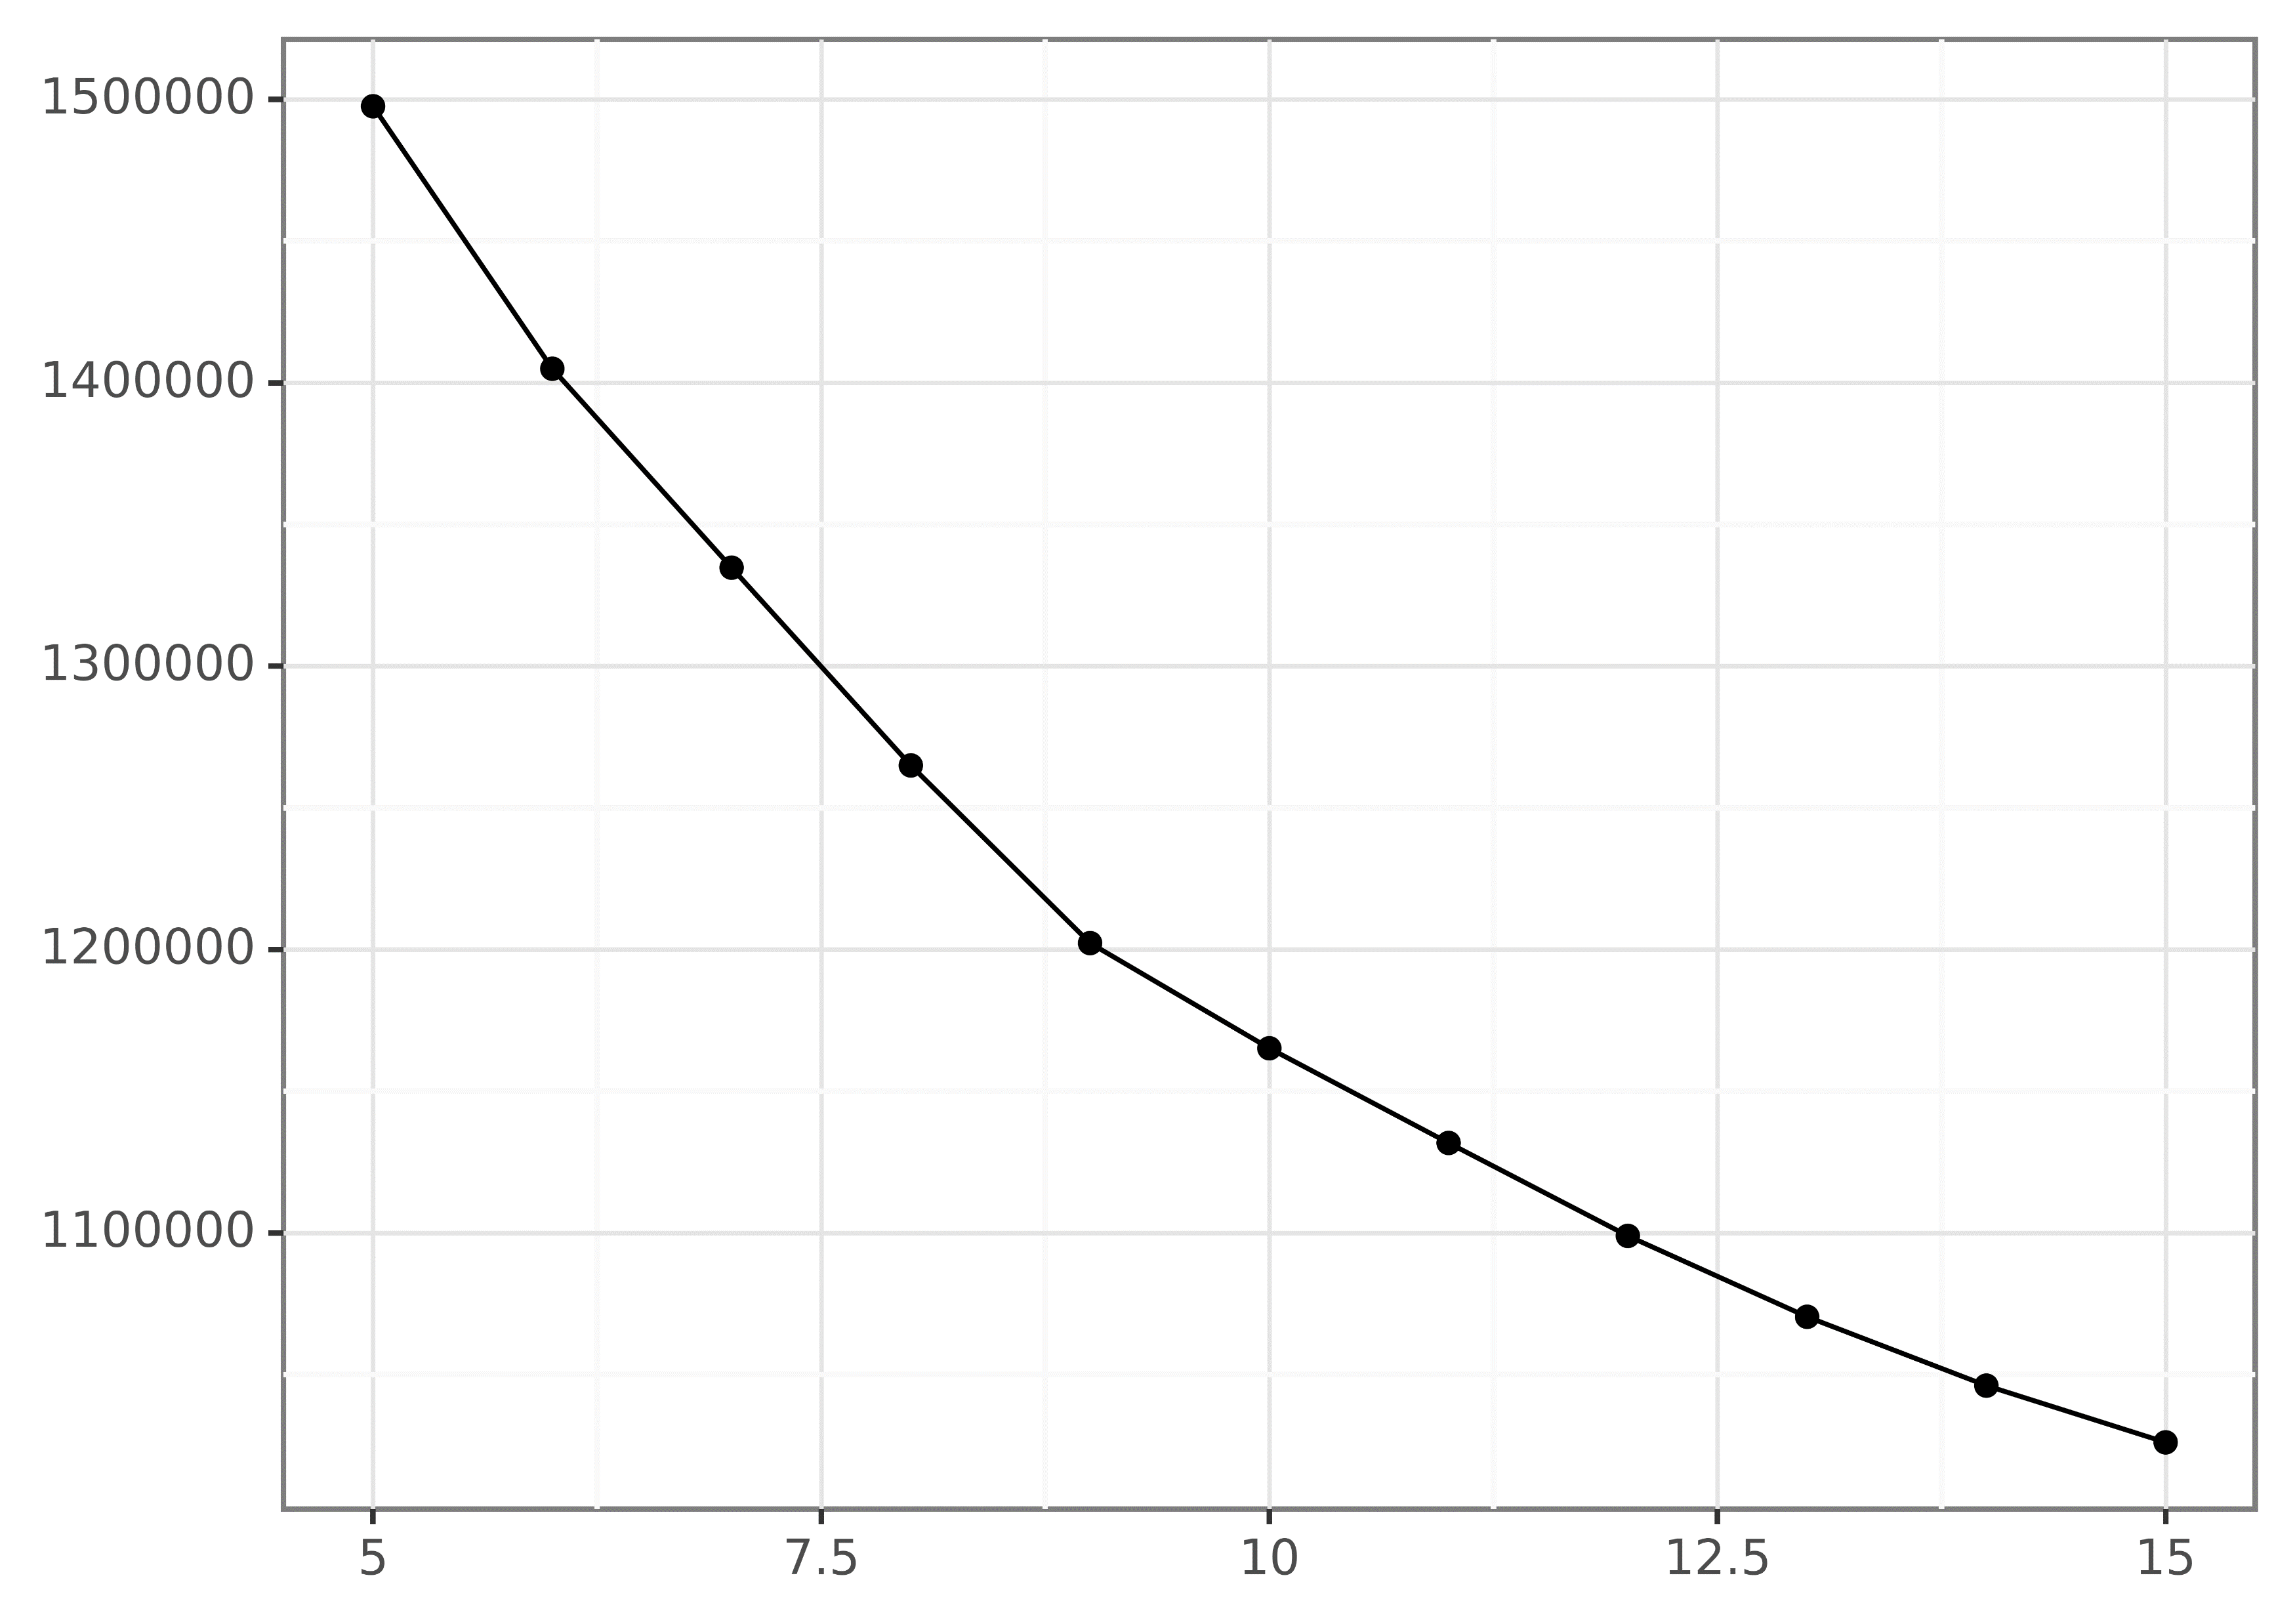
Elbow at k = 9!
Output from
Step 3
Inertia
Value of k
Notes:
While the elbow method is subjective, it is a reasonable assumption that most people would choose k = 9 as the elbow in the scree plot above. Given what you learned about the clusters in Lab 1, the above scree plot is reasonable – despite knowing there are in fact 10 classes in the hand-written digits dataset. Specifically, Step 6 of Lab 1 demonstrated cluster label 3 was heavily split between actual labels 1 and 8. It’s possible that with k = 9, cluster label 3 members would be allocated to other clusters, producing the elbow visualized above.

Slide 77
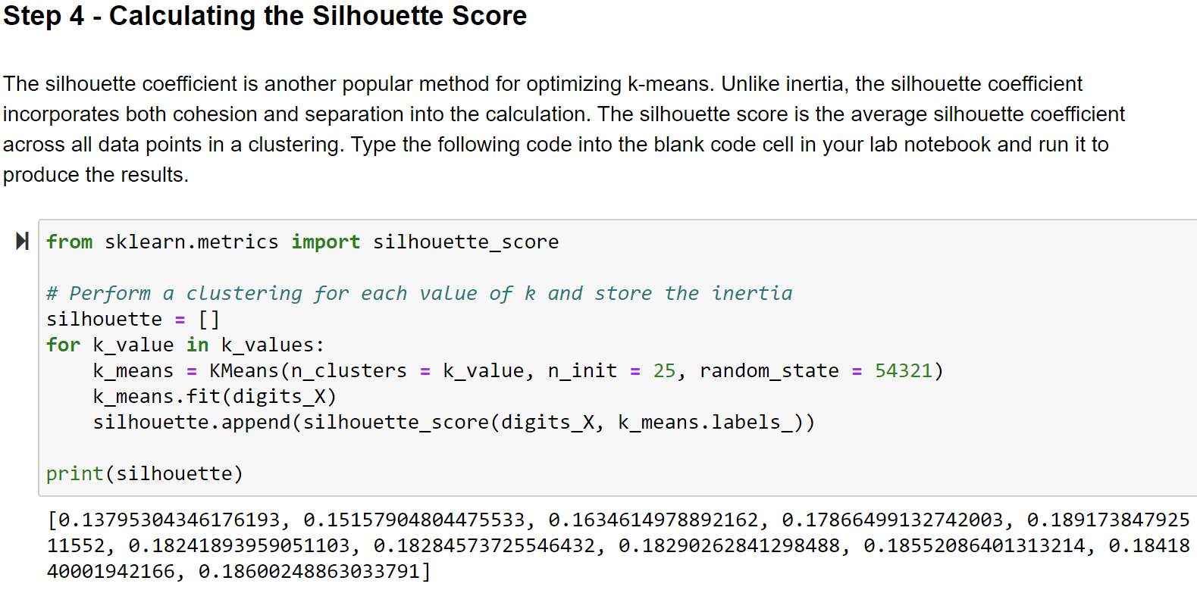
Notes:
The code above reuses the k_values object from Step 3. The code above performs a total of 11 k-means cluster analyses using values of k ranging from 5 to 15 and ensuring reproducibility by setting the random seed to the same value for each clustering.

Slide 78
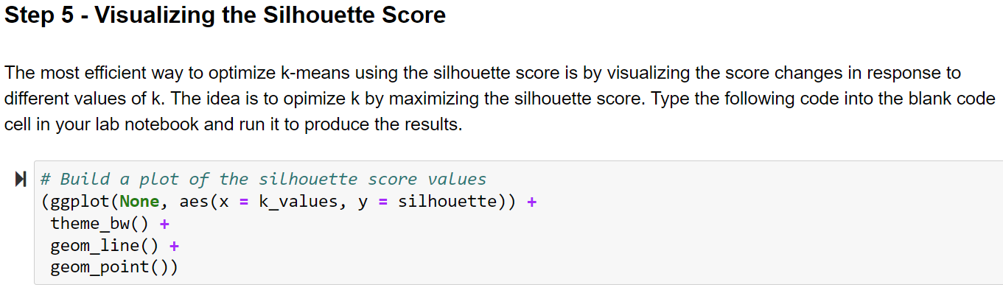

Slide 79
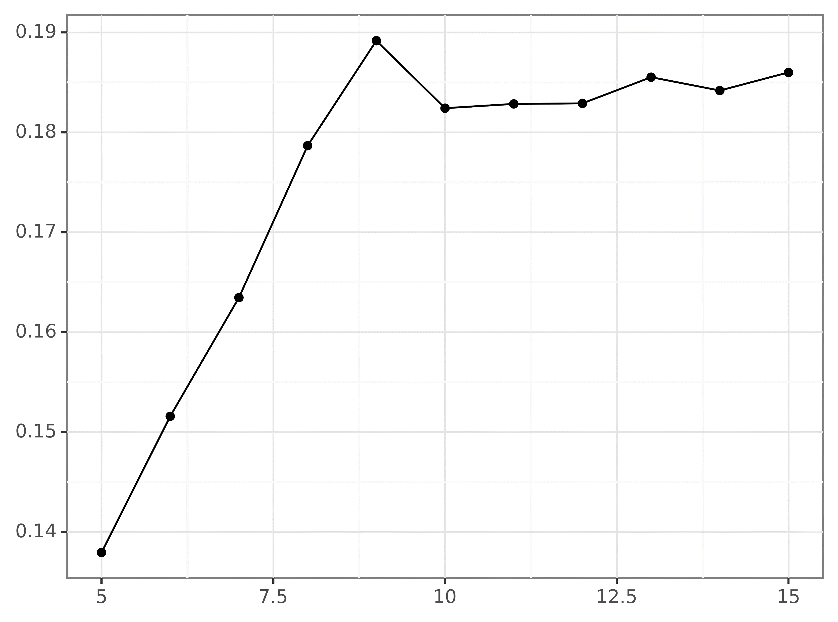
Max silhouette score at k = 9!
Output from
Step 5
Silhouette Score
Value of k
Notes:
As discussed during lecture, it is a good practice to use both the elbow method with inertia and silhouette score when optimizing k-means. As demonstrated in this lab, the results are clear – the clustering is optimized when k = 9. Given that you know there are 10 classes in the hand-written digits dataset, this result might seem curious. The most likely explanations comes from the data itself. Two examples:
Humans are not consistent in the way they write digits by hand
The data is low resolution. It’s possible that higher resolution representations (e.g., 32x32 pixels) might allow for better clusters

Slide 80
DBSCAN
Section 6

Slide 81
Introducing DBSCAN
The density-based spatial clustering of application with noise (DBSCAN) algorithm is a density-based, partial partitioning clustering technique.
Now that’s what I call shock and awe!
Let’s break that down:
DBSCAN uses areas of low data point density vs. areas of high data point density to find clusters
The clusters produced by DBSCAN can be arbitrarily shaped
Not all data points are assigned to clusters – unassigned data points are called noise points
Non-noise data points will be assigned to a single cluster
DBSCAN is one of the most popular clustering techniques.
Two reasons for DBSCAN’s popularity is its flexibility compared to k-means and DBSCAN’s relatively simple algorithm.
Notes:
For more information on k-means, check out the Wikipedia article:
https://en.wikipedia.org/wiki/DBSCAN

Slide 82
The DBSCAN Algorithm
The DBSCAN algorithm is built according to the following definitions:
Core points: These are data points inside a cluster. A data point is core if it is surrounded by a minimum number of other data points within a set distance. When you use DBSCAN you set the distance (known as eps) and the minimum number of points within the distance (known as min_samples).
Border points: A border point is not a core point, but falls within the set distance (i.e., eps) of a core point.
Noise points: A noise point is any point that is neither a core point nor a border point.
Here’s the DBSCAN algorithm:
Label all data points as core, border, or noise points
Eliminate noise points
Connect all core points that are within eps distance of each other
Make each group of connected core points a separate cluster
Assign each border point to one of the clusters based on proximity to core points
Selecting the right values for eps and min-samples is a non-trivial problem. We’re going to cover that in the next section of the course.

Slide 83
A Contrived Example
Consider a hypothetical dataset that needs to be clustered. To keep things simple, there are only two numeric features in the dataset.
Looking at the data, our eyes naturally see the clusters depicted.
We’ll see how the DBSCAN algorithm handles this contrived dataset.

Slide 84
A Contrived Example
The first step in the DBSCAN algorithm is to classify each data point as a core, border, or noise point.
To do that, DBSCAN uses eps for the distance and min_samples for the minimum number of data points.
For this example, eps will be represented by the red circle and min_samples will be 4.
NOTE – min_samples includes the point currently being classified.
eps

Slide 85
A Contrived Example
The DBSCAN algorithm inspects each data point in the dataset.
For brevity, we’ll only consider a few points to illustrate how the algorithm works.
Let’s say the next point to be evaluated is circled.
The total number of points within, or contacted by, the eps circle is 5.
This data point is core. Core points will be designated by blue.

Slide 86
A Contrived Example
The next data point to be classified is in the center of the eps circle.
The total number of points within, or touched by, the eps circle is 3.
This point is not core but is within eps distance of a core point. Therefore, it is a border point.
Border points will be designated by gray.

Slide 87
A Contrived Example
DBSCAN continues the process with all the data points in the data set.
What is depicted here are the results of applying the DBSCAN definitions to the dataset.
Notice that two data points in addition to the four obvious noise points were identified.

Slide 88
A Contrived Example
Next, DBSCAN eliminates noise points and then connects all core points with eps distance of each other.
Groups of connected core points become clusters.
Notice how the found clusters do not match the first slide?

Slide 89
A Contrived Example
Last, DBSCAN assigns border points to clusters based on core point proximity.
How does DBSCAN handle “ties”?
Notice how the found clusters do not match the first slide?
DBSCAN is greedy. When necessary, border points are assigned to the cluster that was created first.
Let’s say that the green cluster was created first.
What about this border point?

Slide 90
A Contrived Example
Voila! DBSCAN has completed the clustering!
Notes:
NOTE – The scikit-learn DBSCAN implementation is deterministic. You will always get the same clustering results for the same set of data, including “tie-breaking” of border points.

Slide 91
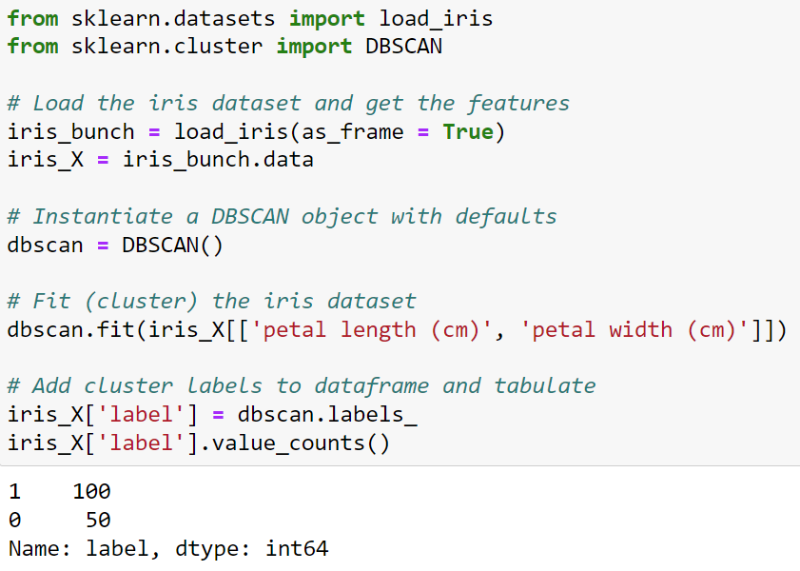
DBSCAN in Python
The DBSCAN class from scikit-learn provides an implementation of the DBSCAN algorithm.
The DBSCAN class offers many constructor parameters allowing you to optimize the algorithm based on the dataset to be clustered.
This example uses the class constructor defaults.
As shown here, using the defaults, the DBSCAN algorithm found two clusters and no noise points (a cluster label of -1 is a noise point).
Notes:
Here are the defaults for the DBSCAN class:
eps = 0.5
min_samples = 5
metric = Euclidian distance
For more information on the DBSCAN class, check out the online documentation:
https://scikit-learn.org/stable/modules/generated/sklearn.cluster.DBSCAN.html

Slide 92
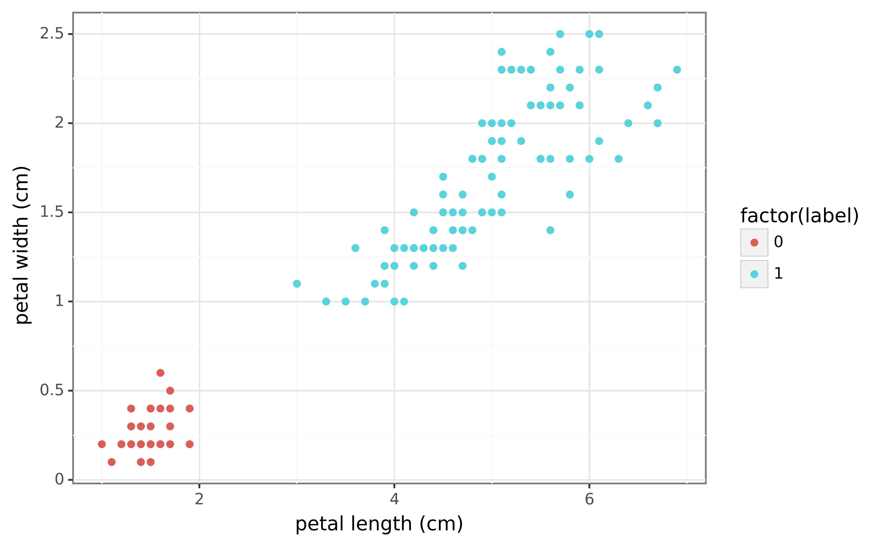
DBSCAN Clustering Results
Notes:
Unlike with a prototype-based based clustering algorithm like k-means, there’s no way to tell DBSCAN about the number of clusters to find – even if subject matter expertise can provide a good estimate of how many classes are lurking in the dataset.

Slide 93
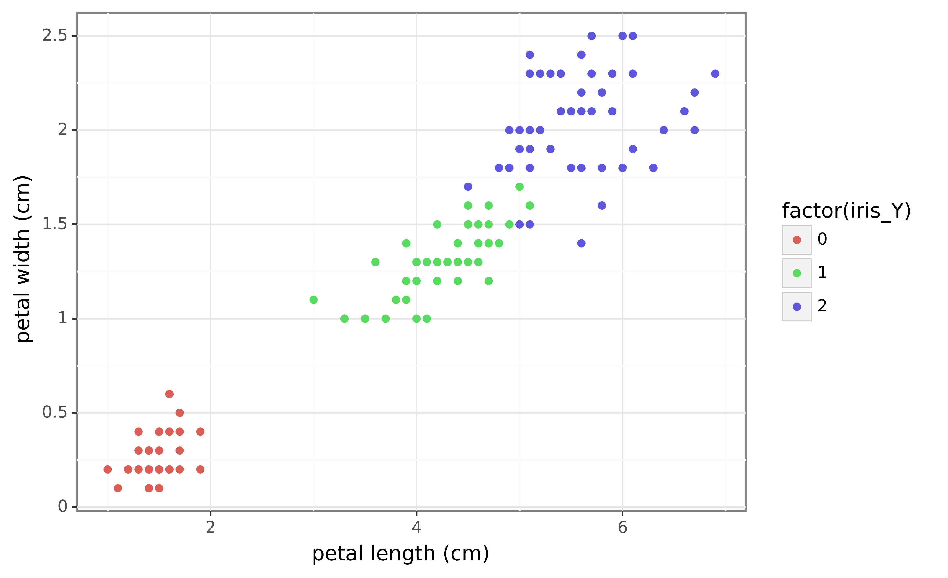
Iris Ground Truth

Slide 94
DBSCAN Caveats
The DBSCAN algorithm always requires optimization as there is no way to tell the algorithm how many clusters to find.
The DBSCAN class uses Euclidian distance by default, but other distance metrics can be used. Always consider if using a different calculation is appropriate for your dataset.
While resilient to outliers (especially compared to k-means), consider whether standardizing your features might improve results based on your distance calculation.
DBSCAN can have problems identifying clusters if there are many areas of radically changing density.

Slide 95
Optimizing DBSCAN
Section 7

Slide 96
Optimizing DBSCAN
Optimizing DBSCAN consists of two steps:
Estimating a reasonable value for min_samples
Using a heuristic based on the estimated value of min_samples to find an optimal eps value
First, estimating min_samples:
A good rule of thumb is the value of min_samples should at least match the number of features to be clustered plus one
Another rule of thumb for min_samples is making it twice the number of features plus one
Next, finding an optimal eps value employs a variation of the elbow method like that used previously with k-means.
For DBSCAN, the metric used for the elbow method is:
Iterate through every data point in the dataset
For each data point, calculate the distance to the min_samples-th nearest data point (e.g., the 5th nearest data point)
Notes:
When calculating the value to use for min_samples, the above is a good place to start. Another consideration is the total size of your dataset. Larger datasets often benefit from even large values of min_samples. For example, when clustering a dataset with 10,000 observations and 25 features, you might find better results with DBSCAN using min_samples values higher than 51 (e.g., a min_samples of 75).
For more information on optimizing DBSCAN, see the following Wikipedia section:
https://en.wikipedia.org/wiki/DBSCAN#Parameter_estimation

Slide 97
Choosing the Eps Value
Once you’ve calculated a value for min_samples, the next step is to choose an optimal value for eps using a variation of the elbow method.
Here’s the intuition behind the method. Let’s say you’ve calculated min_samples to be 5. How large should eps be in this case? Represented graphically:
eps
When eps is too small for a min_samples of 5, many data points will not be clustered.
When eps is too large for a min_samples of 5, many clusters will merge, producing an artificially small number of clusters.
eps
eps

Slide 98
Choosing the Eps Value
How many clusters will result?
Similar to the k-means elbow method, the goal is to find the inflection point for eps based on a specific min_samples value.
Notes:
As depicted above, the eps circle on the far left is likely too small with a min_samples of 5. With such a small eps, there will be very few instances of 5 or more data points within the eps circle. This will cause many noise points to be dropped from the clustering.
By way of comparison, the eps circle on the far right is likely too large with a min_samples of 5. With such a large eps, many (maybe all!) of the data points will be considered core points, resulting in a single cluster.

Slide 99
Introducing Nearest Neighbors
The NearestNeighbors class from scikit-learn can be used to help find the optimal value for eps using the elbow method.
Here’s how the nearest neighbors algorithm works:
Select a value of k that represent the number of nearest neighbors to find, including the current point
Calculate the distance between the current point and all other points
Store the k points with the lowest distance values to the current points
Repeat for all points in the dataset
Using the NearestNeighbors class, we can easily find the distance values for the kth nearest neighbor that maps to the value for min_samples.
This is a bit abstract, let’s look at some code.

Slide 100
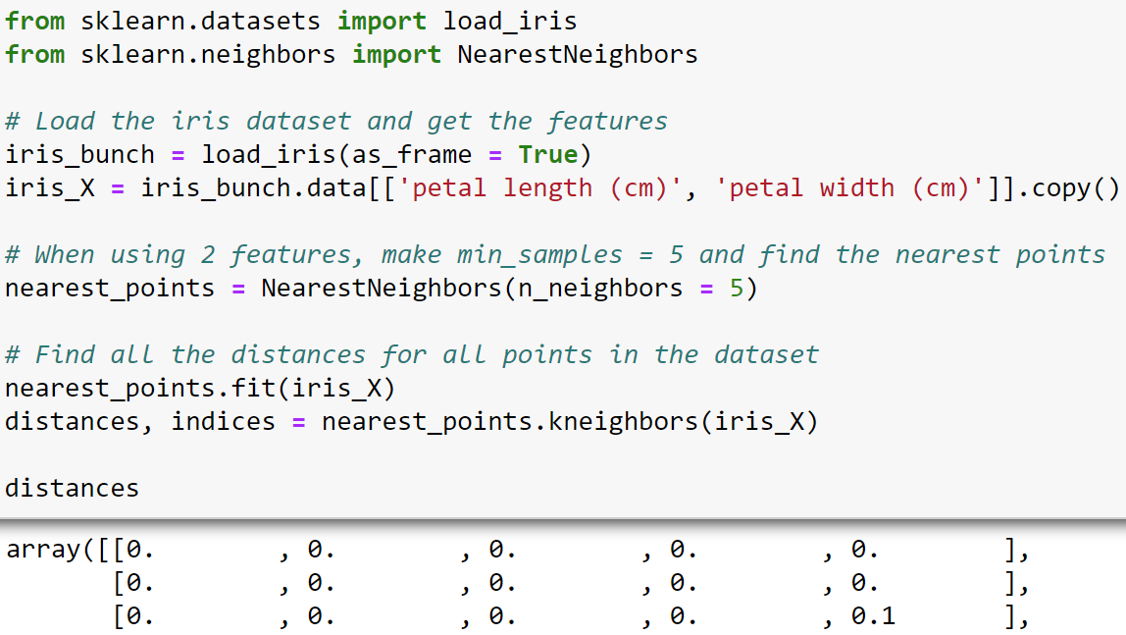
Nearest Neighbors with Python
Avoid pandas copy warnings
Current data point with distance = 0
Distance to 2nd closest
Distance to 3rd closest
Distance to 4th closest
Distance to 5th closest
Notes:
Like DBSCAN, the NearestNeighbors class uses Euclidian distance by default (this can be changed if needed). In the output above, the distances object is a numpy array that is a matrix (i.e., a table) of the Euclidian distances of the nearest 5 neighbors for all observations in the dataset. In the case of the iris dataset, the array has dimensions of 150 rows and 5 columns.
More information on the NearestNeighbors class is available from the online documentation:
https://scikit-learn.org/stable/modules/generated/sklearn.neighbors.NearestNeighbors.html

Slide 101

Eps Elbow Method
Produce a range of values from 0 thru 149

Slide 102

Eps Elbow Method
A k-dist chart for k = 5
Euclidian distance (eps)
Elbow at eps approximately 0.22
Notes:
The above visualization is known as a “k-dist chart” because it plots distance values for a kth nearest neighbor (in this case the 5th nearest neighbor, including the current data point). As with the k-means elbow method, using k-dist charts to find a value for eps is a subjective process. There is no guarantees that the elbow selected is in fact the true optimal value for eps.

Slide 103

DBSCAN Optimization Results
Notes:
NOTE – This code assumes that the iris dataset was loaded using the code from 2 slide previous.

Slide 104

DBSCAN Optimization Results
Noise points
Whoa!
Notes:
The above clustering is an example of where a density-based technique like DBSCAN might not be the most effective. In the case of the iris dataset, there are too many regions of low density, so DBSCAN finds more clusters than expected and also many noise points (i.e., points with a cluster label of -1).
In the case of the iris dataset, a complete prototype-based technique like k-means performs much better because the clusters in the data are spherical and force every data point to belong to a cluster.
It is worthy to note that if the iris dataset had more observations, it is possible that the less dense regions would be “filled in” and allow for DBSCAN to perform better.

Slide 105
K-Means vs DBSCAN
In practice, k-means tends to be used more commonly than DBSCAN for the following reasons:
Optimizing k-means is typically less time-consuming
Many types of data (e.g., customers) tend have spherical clusters
However, when faced with a new dataset, it is a reasonable strategy to try both k-means and DBSCAN.
When optimized results for both algorithms are substantively different, this provides an indication that additional investigation with the dataset is needed.

Slide 106
Hands-on Lab #3
Notes:
Here is the easiest way to get going with the lab:
Start Anaconda Navigator
Within Anaconda Navigator, start Jupyter Notebook
Using the browser, navigate to where the course files are located on your computer
Click on the “Hands-On Lab 3 – DBSCAN.ipynb” listing in the browser window

Slide 107


Slide 108


Slide 109


Slide 110


Slide 111

Output from
Step 4
eps
Area of eps inflection
Distances to 129th nearest neighbor in ascending order
Notes:
As noted previously, the elbow method is subjective. As such, you are actively encouraged to apply your own interpretation to the above curve and experiment with different values of eps.

Slide 112


Slide 113


Slide 114

Notes:
Copying and pasting snippets code from previous cells is very commonly done in Jupyter notebooks – especially when you are iterating through a data analysis.

Slide 115

Output from
Step 7
eps
Area of eps inflection
Distances to 65th nearest neighbor in ascending order
Notes:
Again, you are actively encouraged to apply your own interpretation to the above curve and experiment with different values of eps.

Slide 116

Notes:
The output above shows a much more interesting clustering compared to the first clustering. However, you know from the ground truth of the data (i.e., the dataset has 10 classes), that the above clustering is not ideal. In the next lab you will revisit this dataset using DBSCAN and see how to improve the results.

Slide 117
Dimensionality Reduction
Section 8

Slide 118
Introducing Dimensionality Reduction
Dimensionality reduction is the process of transforming a dataset from its original collection of features (i.e., dimensions) to a new representation with less features while retaining as much of the dataset’s original information as possible.
Dimensionality reduction is common in cluster analysis as distance calculations (e.g., Euclidian distance) are less effective in higher dimensions.
There are many algorithms for performing dimensionality reduction, but we will cover one of the most commonly used in practice – principal component analysis (PCA).
The mathematics of PCA requires knowledge of linear algebra, so we will only focus on the concepts of how PCA works.
We will use the iris dataset to build an understanding of how PCA works.
Notes:
For more detailed coverage of dimensionality reduction and principal components analysis (PCA), check out the following resources:
https://en.wikipedia.org/wiki/Dimensionality_reduction
https://en.wikipedia.org/wiki/Principal_component_analysis
http://www.cs.otago.ac.nz/cosc453/student_tutorials/principal_components.pdf

Slide 119
Dimensionality Reduction
The iris dataset has four features.
Within the combination of these features, there are patterns in the data that naturally cluster the types of flowers.
The chart to the right shows that using just two of the four features provides much information regarding the clusters in the data.
If we could make a visualization like this using more features, it is possible we could get even better information regarding the clusters.

Slide 120

Dimensionality Reduction
Here’s an example of using a three-dimensional visualization of iris dataset to get more information about the clusters.
Unfortunately, using visualizations like this stops at three features. There’s no way to visualize four or more dimensions.
Put another way, our ability to visually recognize patterns breaks down as the number of dimensions increases.
Clustering algorithms suffer the same fate. This is known as the curse of dimensionality.
Notes:
For more information on the curse of dimensionality, check out the following article:
https://en.wikipedia.org/wiki/Curse_of_dimensionality

Slide 121
Introducing PCA
PCA is a method of distilling the information that exists across many dimensions into a far smaller number of principal components (PCs).
Principal components capture the variance inherent in the data along various dimensions, allowing for a much more compact representation of the information of the original dataset.
NOTE – PCA is most effective when there are strong linear relationships in your data.
This is all a bit abstract, so let’s head back to the iris data as an example.

Slide 122

Lines of Best Fit
A line of best fit has been added to the visualization to the right.
You might also be familiar with this idea as trendlines in spreadsheet and data visualization software.
A line of best fit approximates the linear relationship between two or more features.
This idea is key in understanding PCA.
While the example will use only two dimensions, PCA can be used with many dimensions.
Notes:
NOTE – The scale of the axes on this visualization are not the same. This will be important later on.

Slide 123
PCA’s First Steps
petal width
Assume the data to the right is a subset of the iris data from the previous slide.
PCA’s first step is to project the data around the origin.
To do this, PCA calculates the center (i.e., the mean) of the data.
The center then becomes the new origin and all the data points are moved to align with the new origin…
Center of the data
petal length

Slide 124
Finding Principal Component 1
Notice how the data points have the spatial relationships as before, they’ve just been moved to a new origin.
PCA uses the projected data to build the principal components.
The next step is to find the line of best fit that passes through the origin of the projected data.
This line is principal component 1 (PC1).
PCA uses the slope PC1 to understand the relative importance of the dimensions.
petal width
petal length
PC1
Assume the slope of the line of best fit is 0.25.
This means that for every 4-unit increase in petal length, petal width increases by 1 unit.
Notes:
NOTE – As mentioned previously, the scales on the axes of the original visualization were not the same, so the slope of PC1 appears to be steeper.
The 4-to-1 relationship described on this slide is known as a “linear combination” of petal length and petal width.

Slide 125
Finding Principal Component 2
Because we’re only working with two dimensions, principal component 2 (PC2) is simply the line that is perpendicular to PC1.
The slope for PC2 is -4.
That means for every 1 unit increase in petal length, petal width decreases by 4 units.
petal width
PC2
petal length
PC1
Notes:
NOTE – As mentioned previously, the scales on the axes of the original visualization were not the same, so the slopes of PC1 and PC2 appear to be steeper.

Slide 126
Rotating the Components
PCA then reorients the data by rotating the principal components so that PC1 is now the horizontal axis.
PCA now calculates how much of the variation is represented by each PC.
Conceptually think of variation as how far the data points are typically from each PC.
PCA provides a percentage of the overall variation represented by each PC.
For example, assume PC1 represents 75% of the variation and PC2 represents the remaining 25%.
PC2
PC1
Notes:
The visualization on this slide depicts important conceptual aspects of what happens to PCA:
Notice how all the data points are much closer to the new x-axis (i.e., PC1) than the original data? Conceptually, PCA has reduced the variance of the vertical distance of the data points.
Notice how the data points are, on average, closer to the new y-axis (i.e., PC2) than the original data? Conceptually, PCA has reduced the variance of the horizontal distance of the data points.
The above makes PCA beneficial for clustering in two ways with respect to distance calculations (e.g., Euclidian distance):
Reducing the number of features to capture most of the information in the data.
Reducing the magnitude of values used in the distance calculation.
It is also worth noting that a byproduct of PCA is that many of the data points now have negative coordinates compared to the original dataset, where all data points had only positive coordinates (i.e., all the original data points were in the top right quadrant).

Slide 127

PCA in Python
First two PCs account for 97.76% of variance!
PCA-transformed values
Notes:
NOTE – It is common practice to standardize feature data (e.g., using the StandardScaler class) before applying PCA. Given the nature of the iris data (e.g., all measurements are in centimeters), the example skipped this data preprocessing step.

Slide 128


PCA in Python
PC2
PC1
Notes:
The above scatter plot uses the first two principal components where each data point has the ground truth label designated by color.

Slide 129
Hands-on Lab #4
Notes:
Here is the easiest way to get going with the lab:
Start Anaconda Navigator
Within Anaconda Navigator, start Jupyter Notebook
Using the browser, navigate to where the course files are located on your computer
Click on the “Hands-On Lab 4 – PCA.ipynb” listing in the browser window

Slide 130


Slide 131

Notes:
By using PCA the total number of features has been reduced from 64 to 29! As discussed during lecture, distance calculations suffer greatly from the curse of dimensionality. As such, reducing dimensionality before clustering is a common practice to improve clustering results.

Slide 132


Slide 133


Slide 134

Output from
Step 4
eps
Area of eps inflection
Distances to 30th nearest neighbor in ascending order

Slide 135


Slide 136

Notes:
It is interesting to note that cluster label 0 aligns very well to actual label 0 – this is just coincidental. What is more interesting is how strongly DBSCAN was able to cluster hand-written zeroes. When you think about the nature of the DBSCAN algorithm, this makes intuitive sense. The ring shape of the digit 0 lends itself very well to density-based clustering techniques.

Slide 137

Notes:
The above output is interesting in the context of density-based clustering algorithms like DBSCAN. For example, consider the digit 1 which has 83 (almost half!) of its observations labeled as noise points. From a density-based perspective, the digit 1 is mostly a thin, straight line. How might this make it difficult for the DBSCAN algorithm to cluster this digit?

Slide 138
Categorical Data
Section 9

Slide 139
The Problem with Categories
Categorical data is very common in business data. Unfortunately, it wreaks havoc with clustering.
Consider the following example data:
How do you incorporate the values of the Customer Category feature into Euclidian distance?
Also, check out the Zip Code feature. It looks like a number, but it really isn’t.
Categories disguised as numbers are also common in business data.
We need a way to transform categorical data into truly numeric data – enter one-hot encoding.
Customer Category | State | Zip Code
Bronze | MT | 59715
Silver | WA | 98208
Gold | WA | 98021

Slide 140
One-Hot Encoding
One-hot encoding transforms the unique categorical values of a feature into binary features.
That’s a bit abstract, so consider the following example data:
Assume that the data depicted represents all unique categorical values (i.e., levels) in the data set.
One-hot encoding the data results in the following:
Customer Category | State | Zip Code
Bronze | MT | 59715
Silver | WA | 98208
Gold | WA | 98021
Bronze | Sliver | Gold | MT | WA | 59715 | 98208 | 98021
1 | 0 | 0 | 1 | 0 | 1 | 0 | 0
0 | 1 | 0 | 0 | 1 | 0 | 1 | 0
0 | 0 | 1 | 0 | 1 | 0 | 0 | 1
Notes:
NOTE – Many programming languages will not allow a feature name to consist only of a number (e.g., “59715”). Therefore, the one-hot encoding example above is illustrative of the concept. The actual representation will depend on the programming language used.
For more information on one-hot encoding, check out the Wikipedia article:
https://en.wikipedia.org/wiki/One-hot

Slide 141

One-Hot Encoding with Python
In this section of the course, we’ll use the heart dataset.
The heart dataset has a number of categorical features represented as numbers:
Male
ChestPainType
BloodSugar
EEF
Angina
Thal
NOTE – The heart dataset is not missing any data.

Slide 142

One-Hot Encoding with Python
The get_dummies() function from the pandas library is the easiest way to one-hot encode categorical data:
What do you think of these feature names?
Notes:
If you were curious why the function used above is named “get_dummies,” the process for converting categorical data into a collection of binary features is also known as “dummy encoding.” A common name for binary features produced from categorical data is “dummy variables.” For more information on the topic of dummy variables, check out the following Wikipedia article:
https://en.wikipedia.org/wiki/Dummy_variable_(statistics)

Slide 143

One-Hot Encoding with Python
Better names!
NOTE – The default separator is an underscore, but you can specify the separator you want used.
Notes:
For more information on the pandas get_dummies() function, check out the online documentation:
https://pandas.pydata.org/docs/reference/api/pandas.get_dummies.html

Slide 144


One-Hot Encoding with Python
Original features removed and one-hot encodings added to the end of the dataframe

Slide 145

Working with Mixed Data
When a dataset has both numeric and categorical features, it is known as mixed data.
Mixed data is very common in analytics. Take, for example, the heart dataset:
While it is possible to one-hot encode categorical data, making the data numeric, technically the data is not applicable for most distance calculations used.
For example, one-hot encoded data shouldn’t be used with Euclidian distance.

Slide 146
Factor Analysis of Mixed Data
A popular technique when clustering mixed data is factor analysis of mixed data (FAMD).
Think of FAMD as a mix of principal component analysis (PCA) for numeric data and a technique called multiple correspondence analysis (MCA) for the categorical data.
Conceptually, MCA is very much like PCA in terms of what it does. MCA is also like PCA in that the mathematics are beyond the scope of this course.
As with PCA, we’ll build an intuitive understanding of what MCA does.
Notes:
For more information on FAMD, check out the Wikipedia article on the subject:
https://en.wikipedia.org/wiki/Factor_analysis_of_mixed_data

Slide 147
Contingency Tables
MCA makes use of contingency tables. Think of contingency tables as being like spreadsheet pivot tables.
Consider the following contingency table of the ChestPainType and EEG features of the heart dataset:
We can turn these into probabilities by dividing every row cell by the row total:
 | EEG = 0 | EEG = 1 | EEG = 2 | Row Total
ChestPainType = 1 | 7 | 0 | 13 | 20
ChestPainType = 2 | 52 | 0 | 32 | 84
ChestPainType = 3 | 135 | 3 | 99 | 237
ChestPainType = 4 | 212 | 4 | 300 | 516
 | EEG = 0 | EEG = 1 | EEG = 2 | Row Total
ChestPainType = 1 | 0.35 | 0 | 0.65 | 1.0
ChestPainType = 2 | 0.619 | 0 | 0.381 | 1.0
ChestPainType = 3 | 0.5696 | 0.0127 | 0.4178 | 1.0
ChestPainType = 4 | 0.4109 | 0.0078 | 0.5813 | 1.0

Slide 148
MCA Geometry
The probabilities of the contingency table can be mapped geometrically to a 3D space.
 | EEG = 0 | EEG = 1 | EEG = 2 | Row Total
ChestPainType = 1 | 0.35 | 0 | 0.65 | 1.0
ChestPainType = 2 | 0.619 | 0 | 0.381 | 1.0
ChestPainType = 3 | 0.5696 | 0.0127 | 0.4178 | 1.0
ChestPainType = 4 | 0.4109 | 0.0078 | 0.5813 | 1.0
EEG = 0
EEG = 1
(0.35, 0, 0.65)
With all the points plotted in the space, like PCA, MCA projects the data points to a new origin and finds principal components for the data:
EEG = 2
PC2
PC1
Notes:
Like PCA, the results of MCA not only reduce the number of dimensions required to capture most of the information present in the data, but it also reduces the magnitude of the vertical and horizontal distances. Both make for more effective distance calculations when clustering.
For more information on correspondence analysis, check out the following book:
https://www.amazon.com/Correspondence-Analysis-Practice-Interdisciplinary-Statistics/dp/1498731775/

Slide 149

Setting Categorical Features
When using FAMD in Python, string feature types are treated as categorical data:
Notes:
NOTE – The code in the slide above assumes the heart dataset has been loaded as a pandas DataFrame via the read_csv() function.

Slide 150

Setting Categorical Features
Notes:
NOTE – The pandas library denotes strings as type “object.”

Slide 151

FAMD with Python
The FAMD class from the prince library provides the functionality we need:
89.55% of variance accounted for
Notes:
Compared to the results of PCA on purely numeric datasets, FAMD typically needs many more components to explain a high level of variance. In the case of the heart dataset, almost half of the features are categorical. This relatively high level of categorical data necessitates using all the components.
For more information on the FAMD class, check out the online documentation here:
https://maxhalford.github.io/prince/famd/

Slide 152

FAMD with Python

Slide 153
Course Wrap-Up
Section 10

Slide 154

Continue Your Learning
This is the 1st edition.
Notes:
Link to the latest edition of the book on Amazon:
https://www.amazon.com/Introduction-Mining-Whats-Computer-Science/dp/0133128903/

Slide 155

Let’s Connect!
LinkedIn:
https://www.linkedin.com/in/davelanger/
Email:
dave@daveondata.com

Slide 156

Like the Class? Give a Shout-out!

Slide 157
Need Team Training?
I am proud to partner with TDWI to provide a catalog of hands-on team training offerings.
Courses can be delivered onsite with your team for a classroom experience or virtually (e.g., via Zoom).
Curriculums can be customized for your team’s specific needs and include:
*This Course* Cluster Analysis for Data Science with Python (1 day)
Visual Data Analysis with Python (1 day)
Linear Regression with Python (1 day)
Logistic Regression with Python (1 day)
Introduction to Machine Learning with Python (2 days)
Data Wrangling for Machine Learning with Python (1 day)
Text Analytics for Data Science with Python (1 day)
For more information, contact Yvonne Baho, TDWI Director of Enterprise Learning: ybaho@tdwi.org

Slide 158
THANK YOU!
Happy Data Sleuthing

Slide 159
Hands-on Lab #5

Slide 160


Slide 161

Notes:
If the label column of the dataset (i.e., HeartDisease) is not removed before FAMD, the information contained in the label would be included in the FAMD calculations. This would, of course, distort the FAMD-transformed data and the subsequent clustering.

Slide 162


Slide 163


Slide 164


Slide 165

Notes:
When evaluating the cluster, pay attention to how well the cluster label splits the actual label data. Ideally, the cluster is 100% aligned with one actual label value, although this is extremely rare in practice.

Slide 166

Notes:
When evaluating the cluster, pay attention to how well the cluster label splits the actual label data. Ideally, the cluster is 100% aligned with one actual label value, although this is extremely rare in practice.

